Slide 1

Recruitment Management System
Project Report
As Partial Fulfillment of
Master of Science (Information Technology) – MSc (IT)
Semester-IV
Developed at
InfosenseGlobal Pvt Ltd.
Developed by
Krishna Solanki (202000819010051)
&
ET Team
Under Guidance of
Dr. Darshita kalyani, FCAIT-MSc (IT) Programme,
Mr. Devang Patel, Director @InfosenseGlobal Pvt. Ltd
Faculty of Computer Applications & Information Technology MSc (IT) Programme
GLS University

Slide 2
Project Profile
Project Title: | Recruitment Management System
Description: | A Recruitment management system is an online portal where user can apply remotely for posted job application.to mainly achieve goal of smoothening the recruitment process.
Objective: | A portal where user can apply for posted jobs by company and schedule all the process online.
Project Category: | Website/portal
Tools Used / Required: | Development side ⮚ Hardware: (include only if specific h/w device is used…) ⮚ Software: (include as per need) ✔ Operating System: Windows NT/2000/Windows 10 ✔ Front End: Angular ✔ Middleware: Dotnet ✔ Back End: SQLserver ✔ Framework: ✔ Report Generation: High chart Deployment side ⮚ Hardware: ⮚ Software:
Developed at: | InfosenseGlobal Pvt Ltd
Developed By: | Krishna Solanki & ET Team | 202000819010051 Krishna Solanki | Institute FCAIT
Guided By: | Dr Darshita Kalyani | Internal at Institute | External at company
 |  | Name: Mr mohmadhusain vora Designation: Project Lead | Name: Designation:

Slide 3
Context
Self-study briefing
Node Js
Angular
Git & GitHub
Internship works

Slide 4
Starting With Node JS
A brief introduction on Node JS.
What is Node JS how?
How it works as a server actually?
Reading blogs on medium.com and watch some basic overview on YouTube about "V8"Engine of Node Js.
Installation of Node JS on local machine.

Slide 5
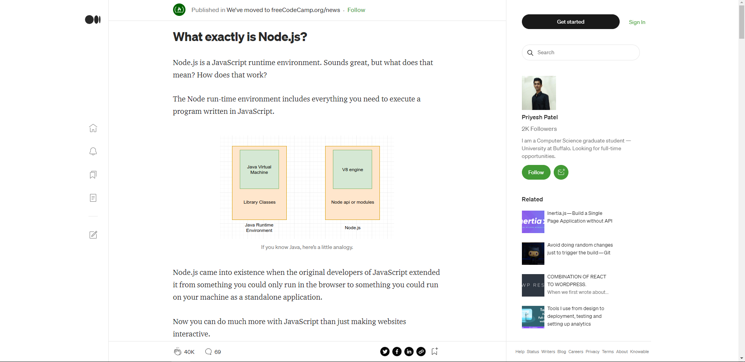
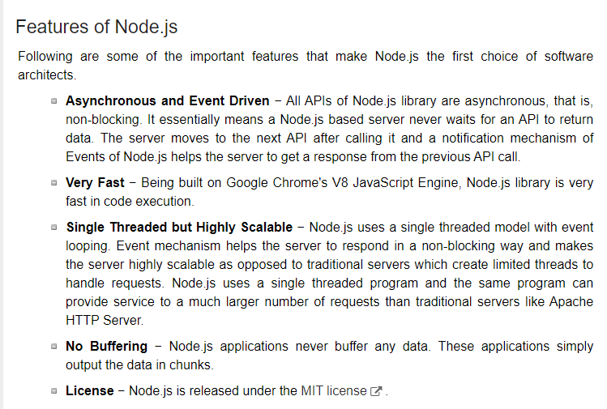
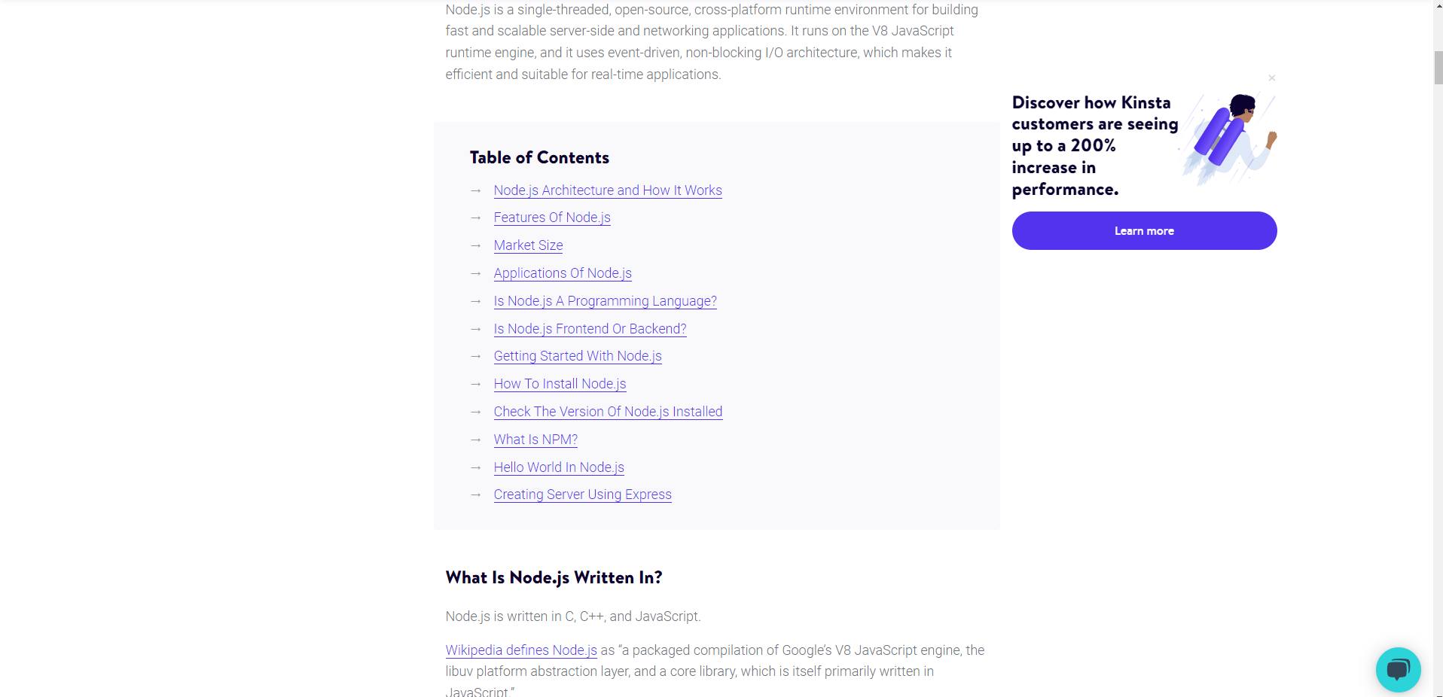

Slide 6
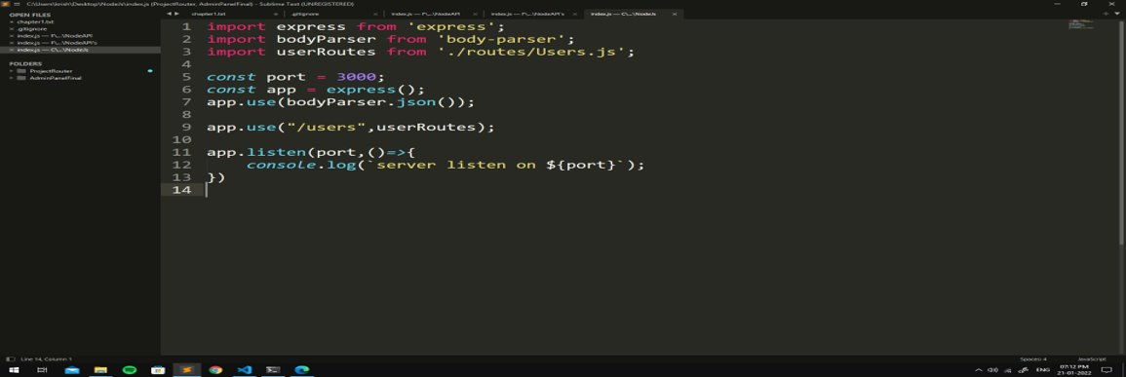
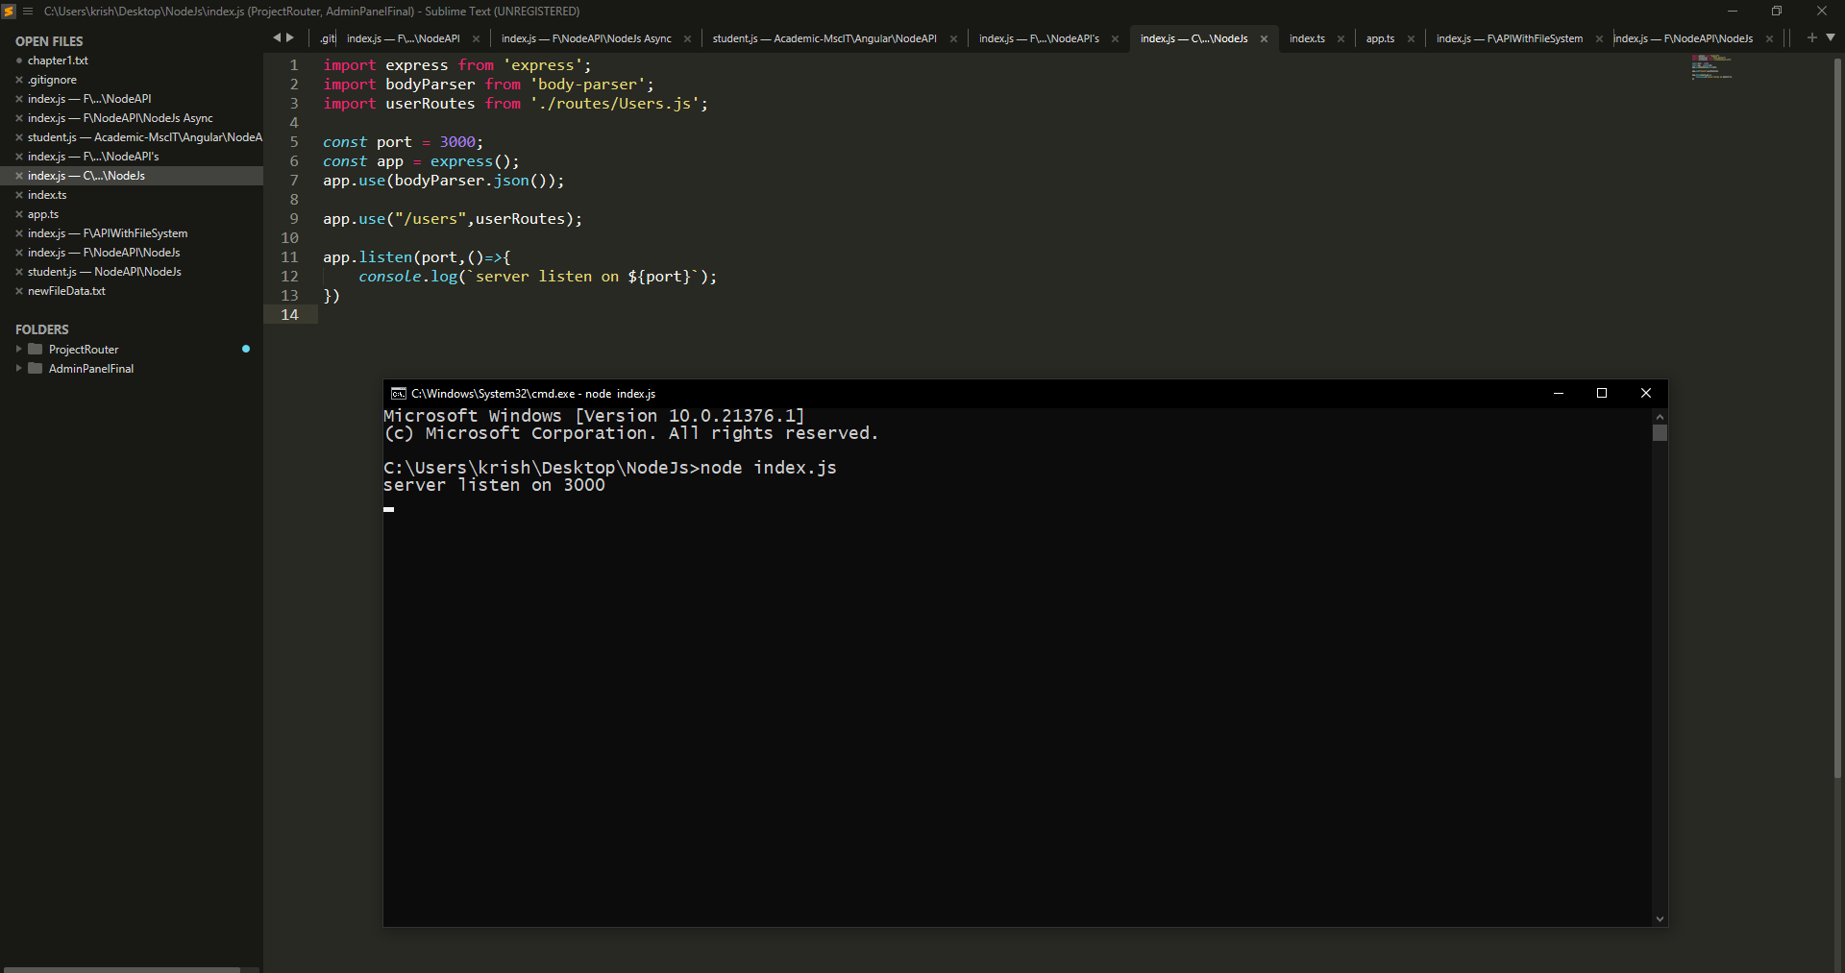
A first server listening program using Node JS
Output will show the port number on which server listening on.

Slide 7
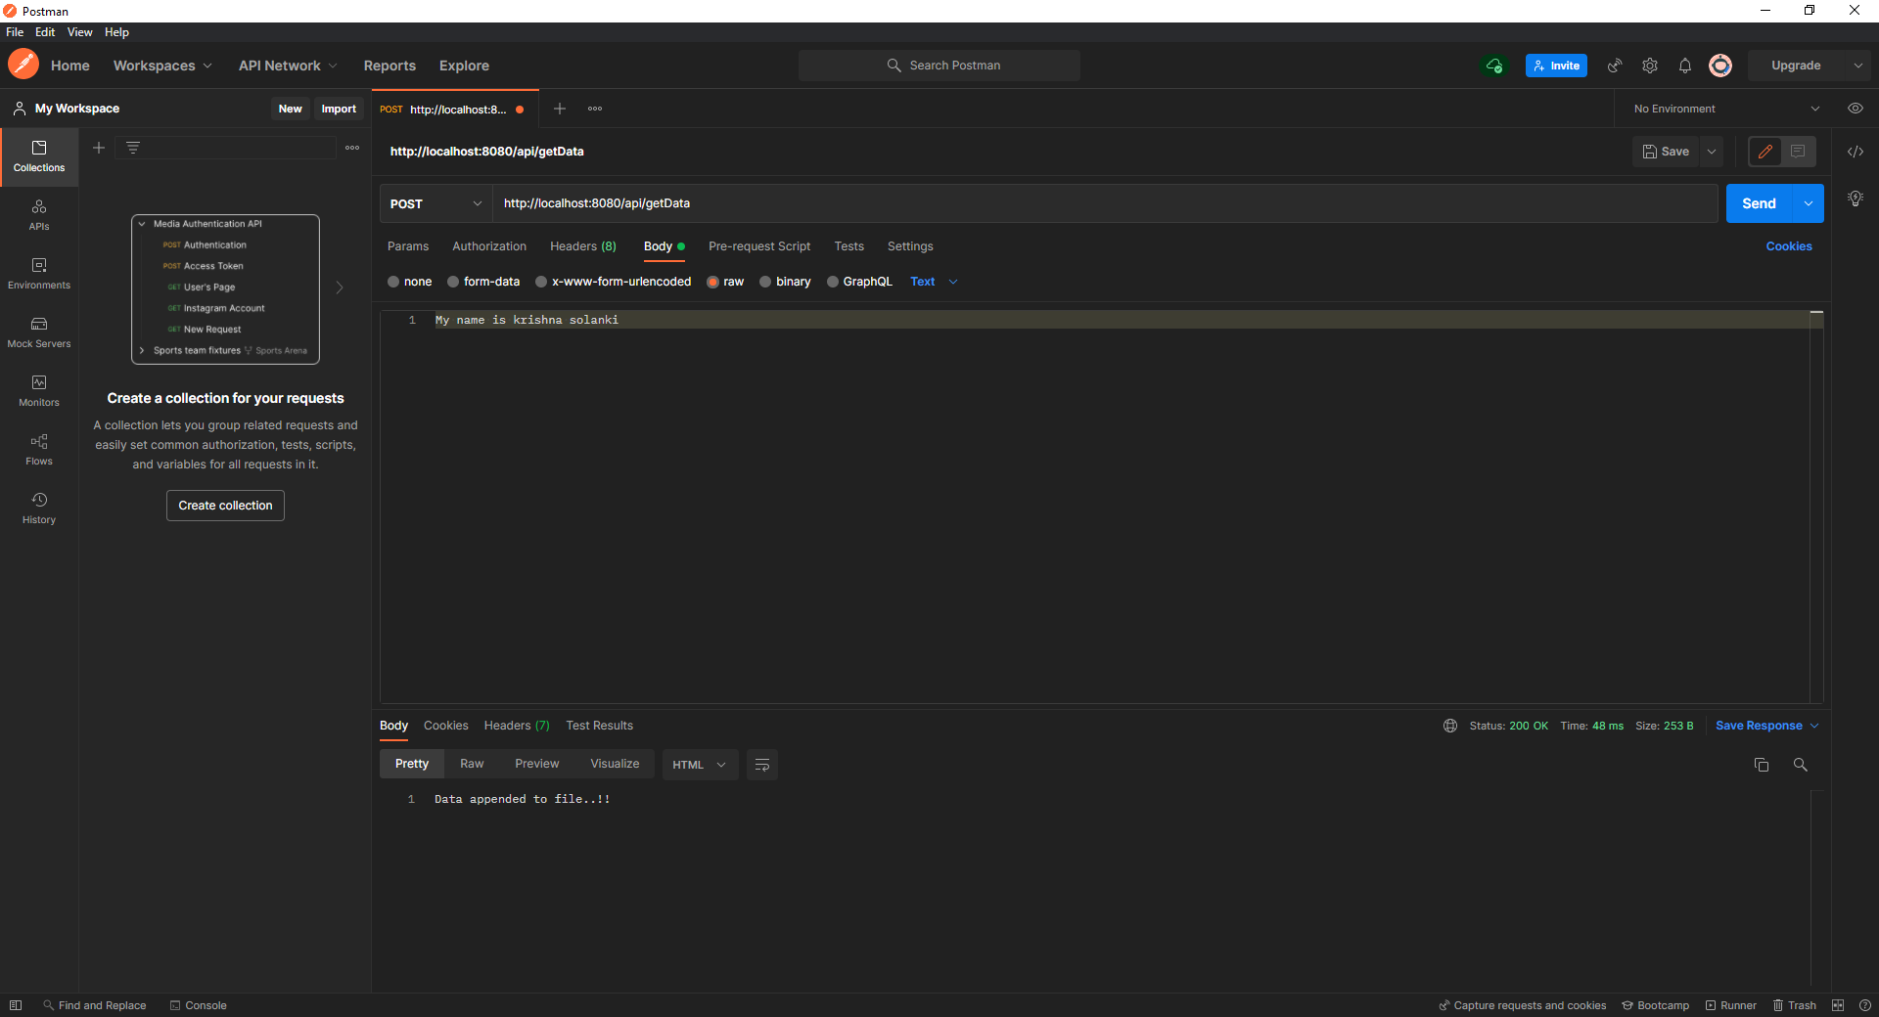
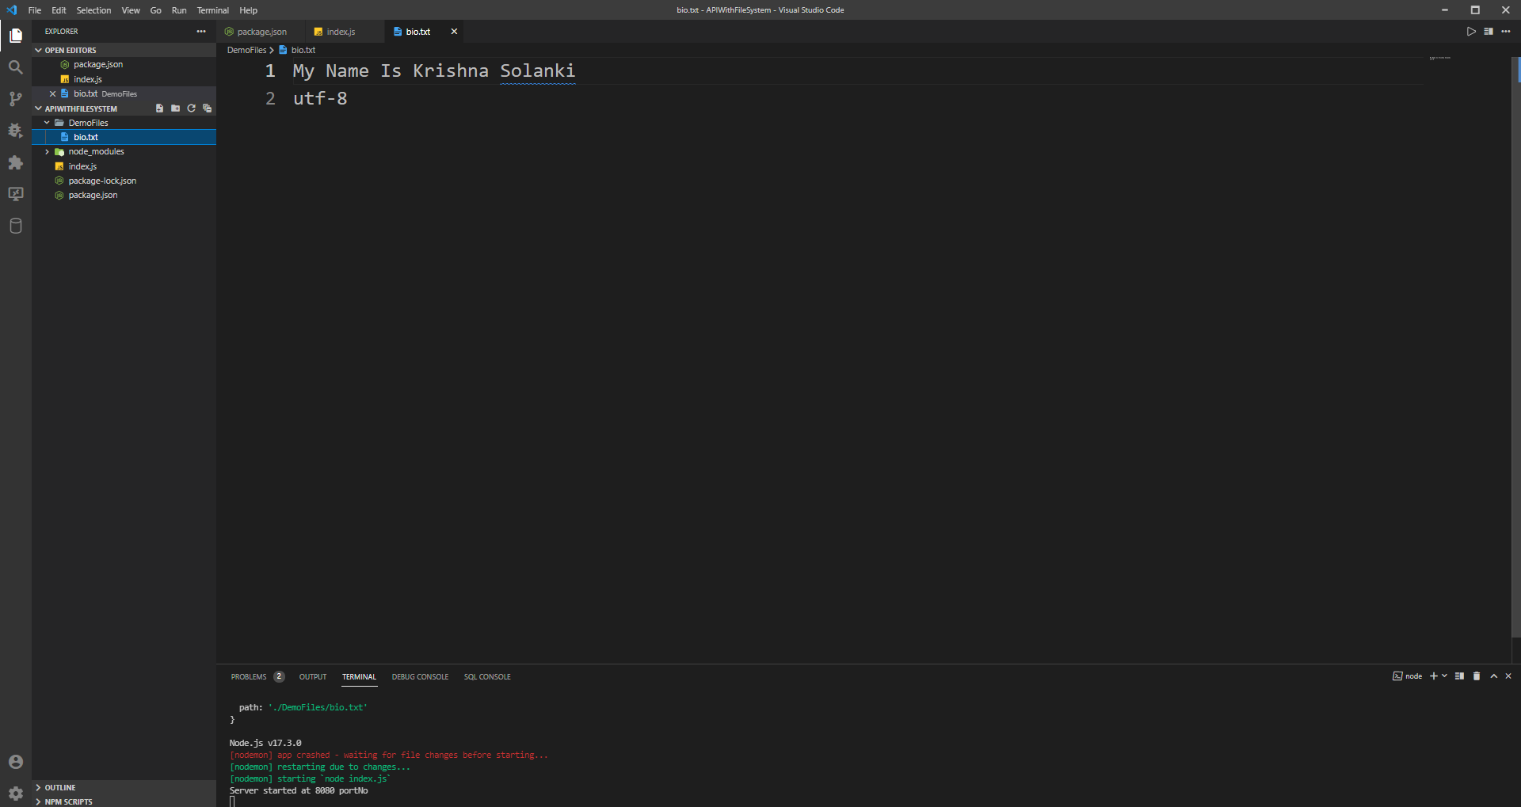
Using Postman App firing API's
Here in below images you can see using postman post Api get fired and data saved into files.
CRUD operations
(Using only text format)

Slide 8
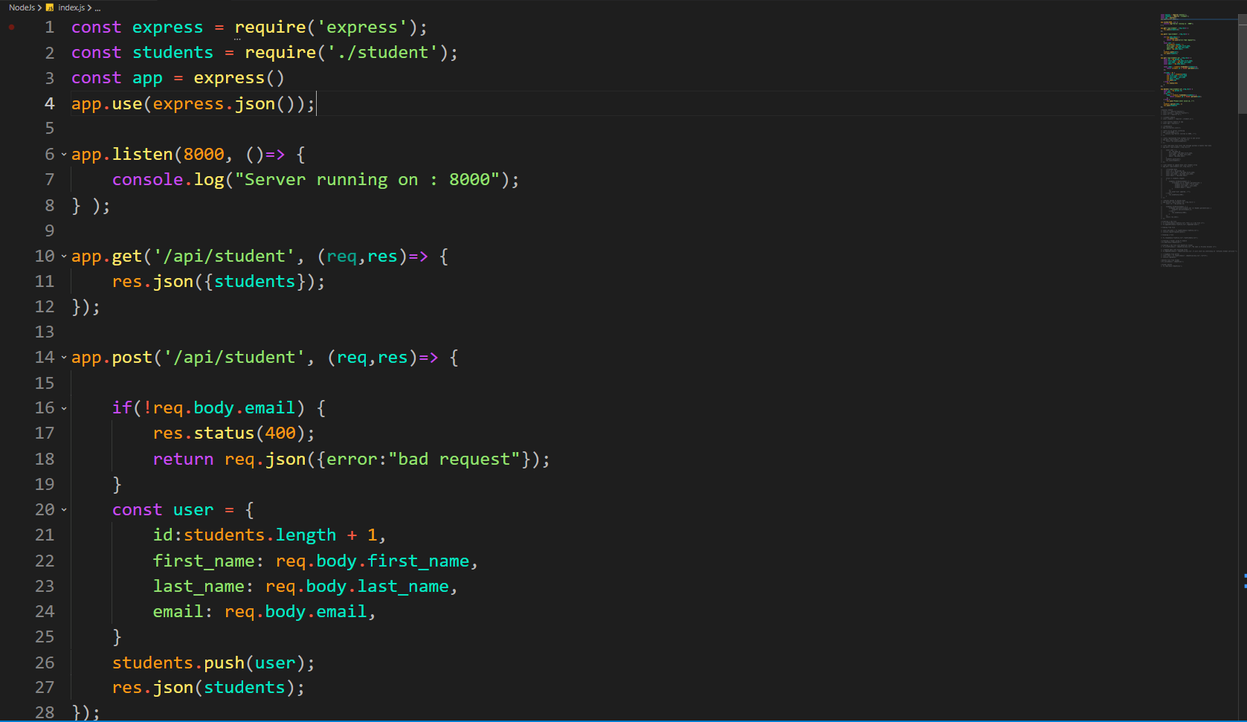
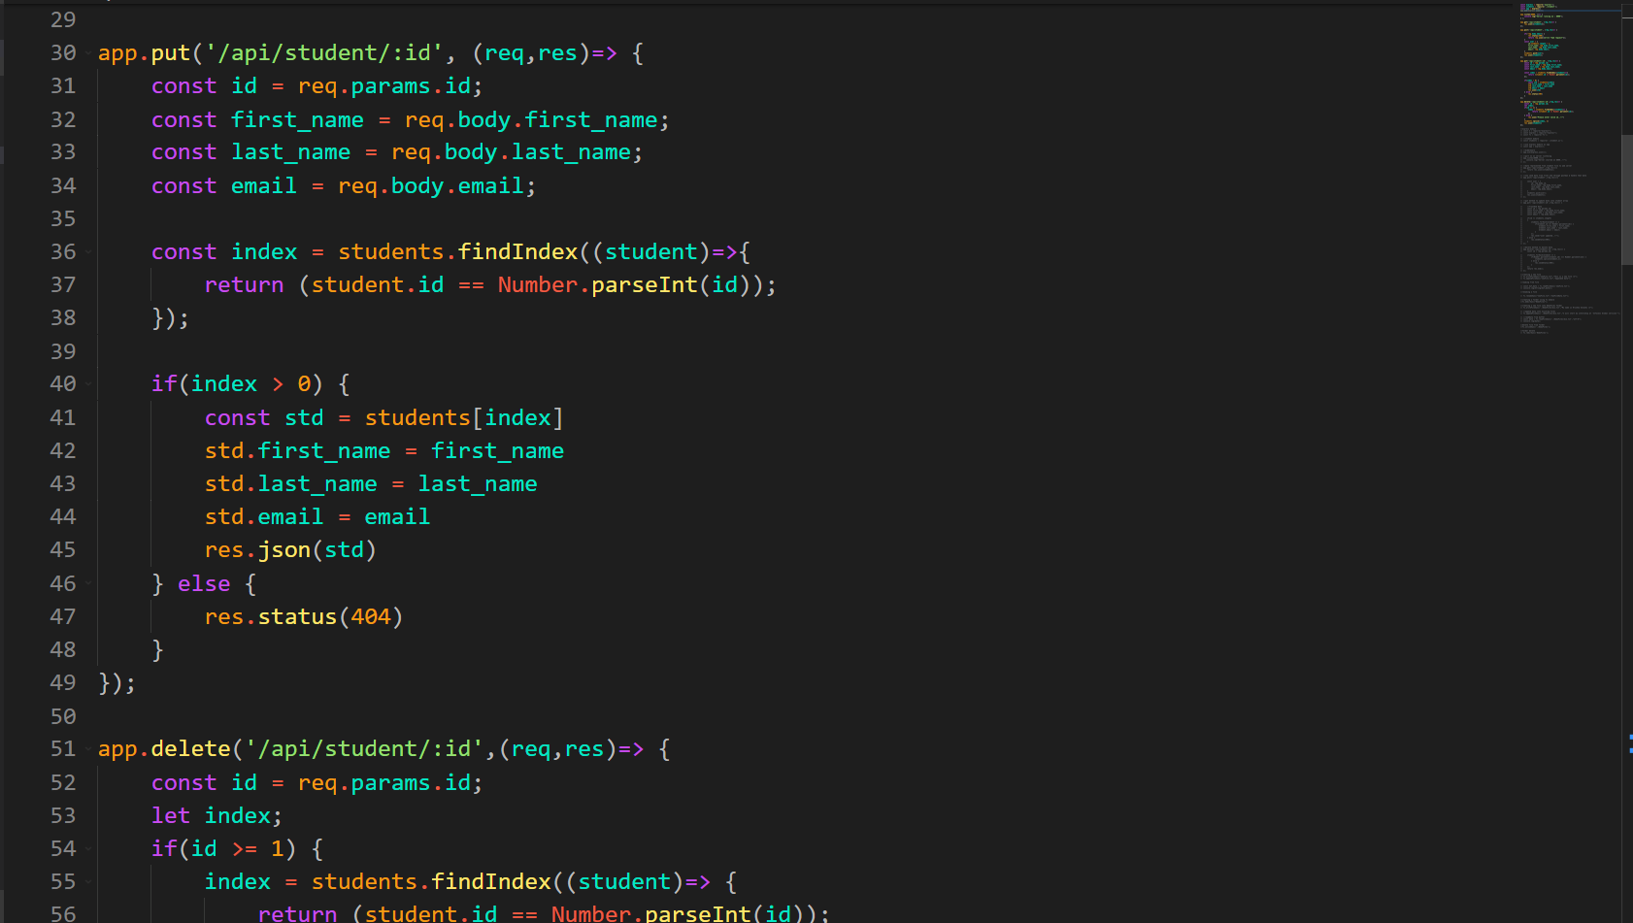
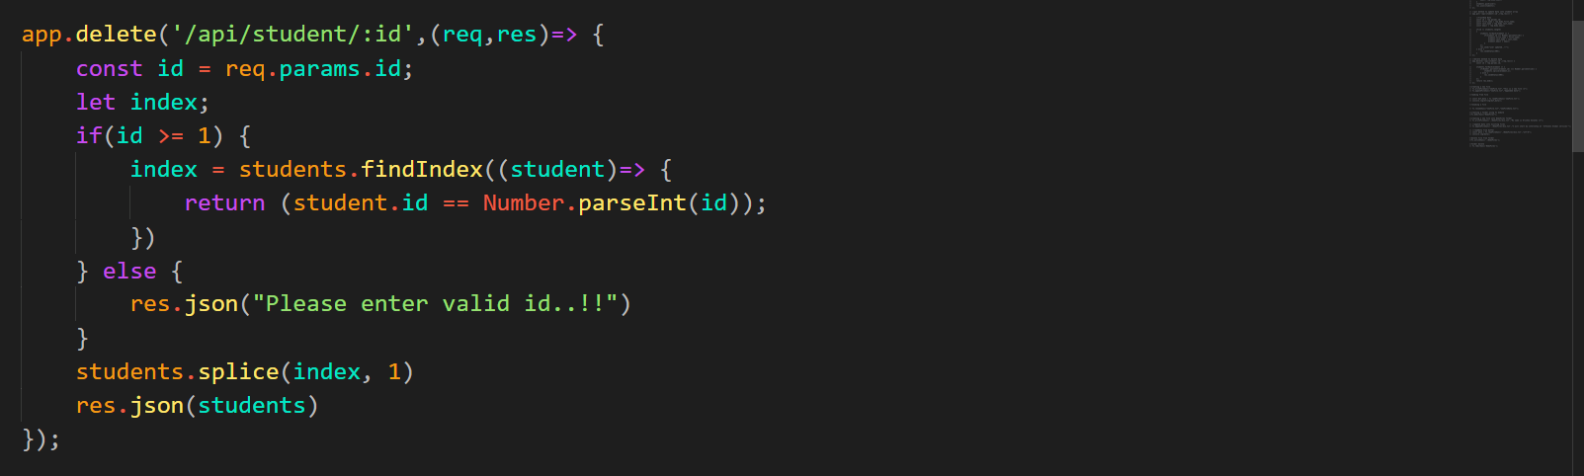
File Storage System:
A first server listening program using Node JS(8000) All the CRUD operation API's(GET,POST,PUT,DELETE)

Slide 9
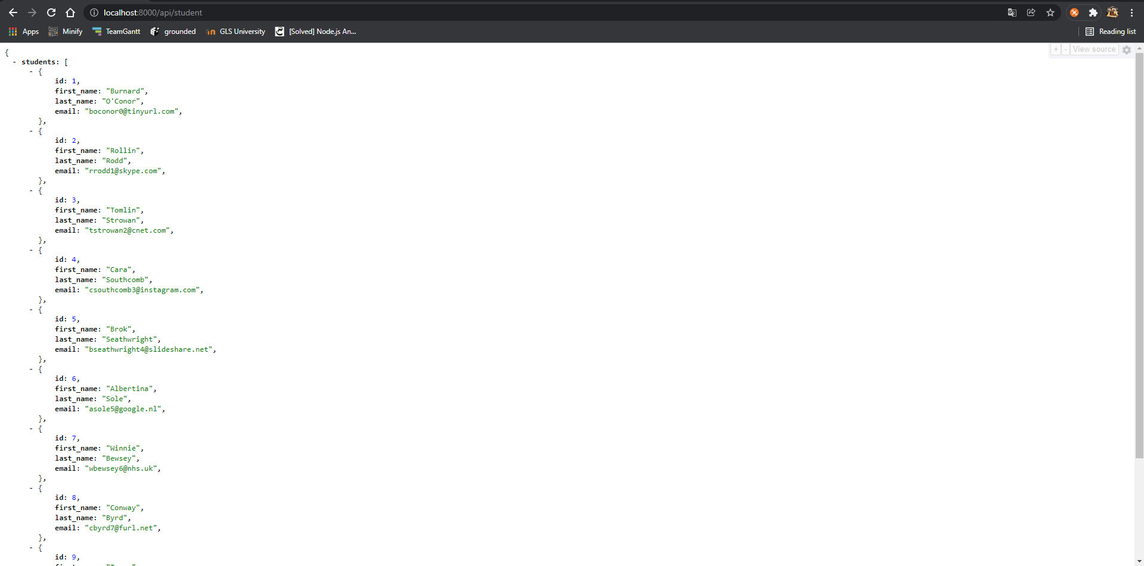
File Storage System:
Get API's calling give below output

Slide 10
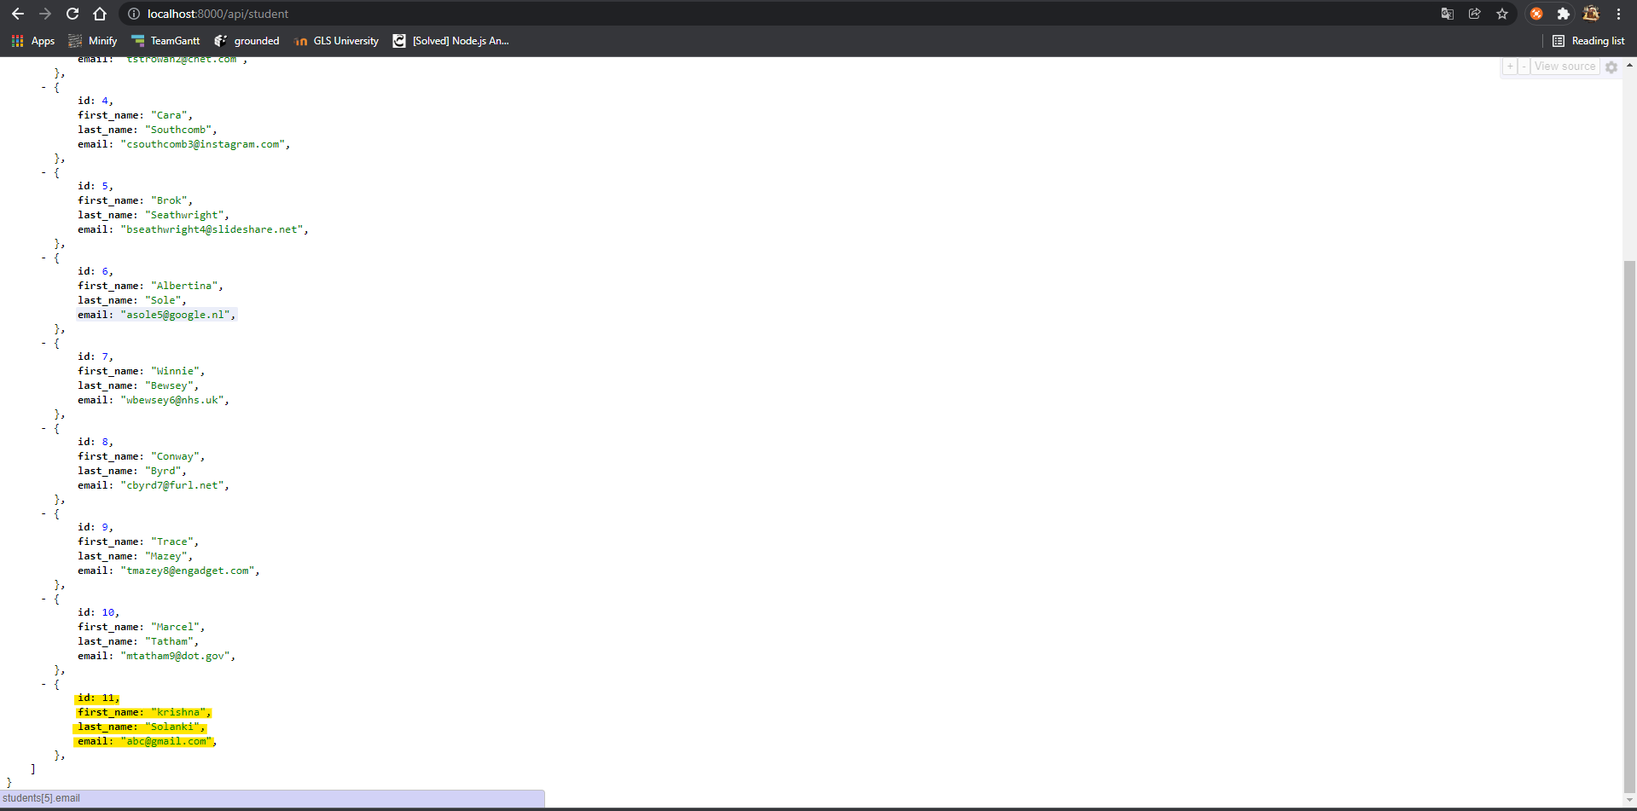
File Storage System:
Post API's calling (push data into json format)

Slide 11
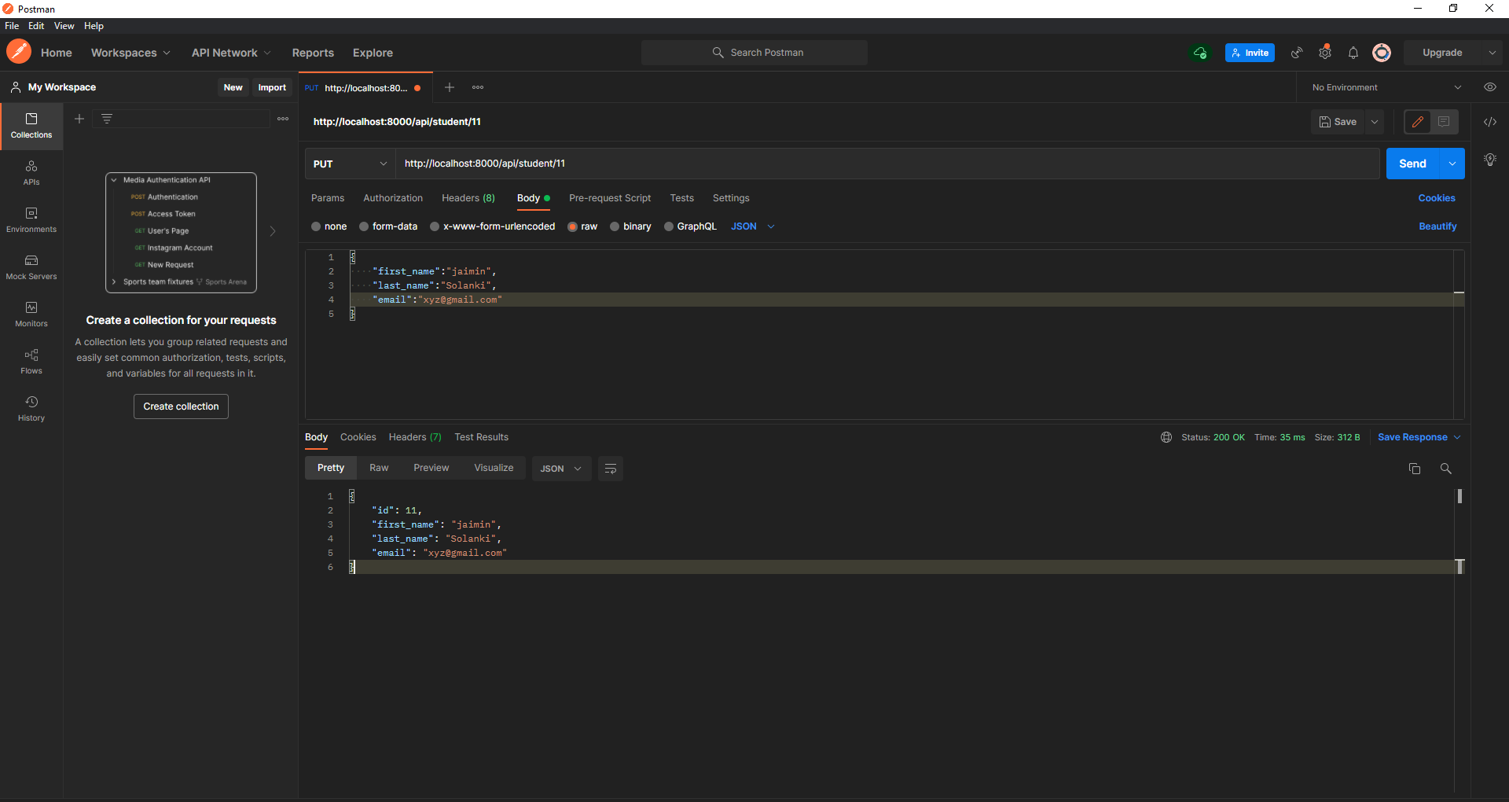
File Storage System:
Put API's calling using postman(below is updated one student using id)

Slide 12
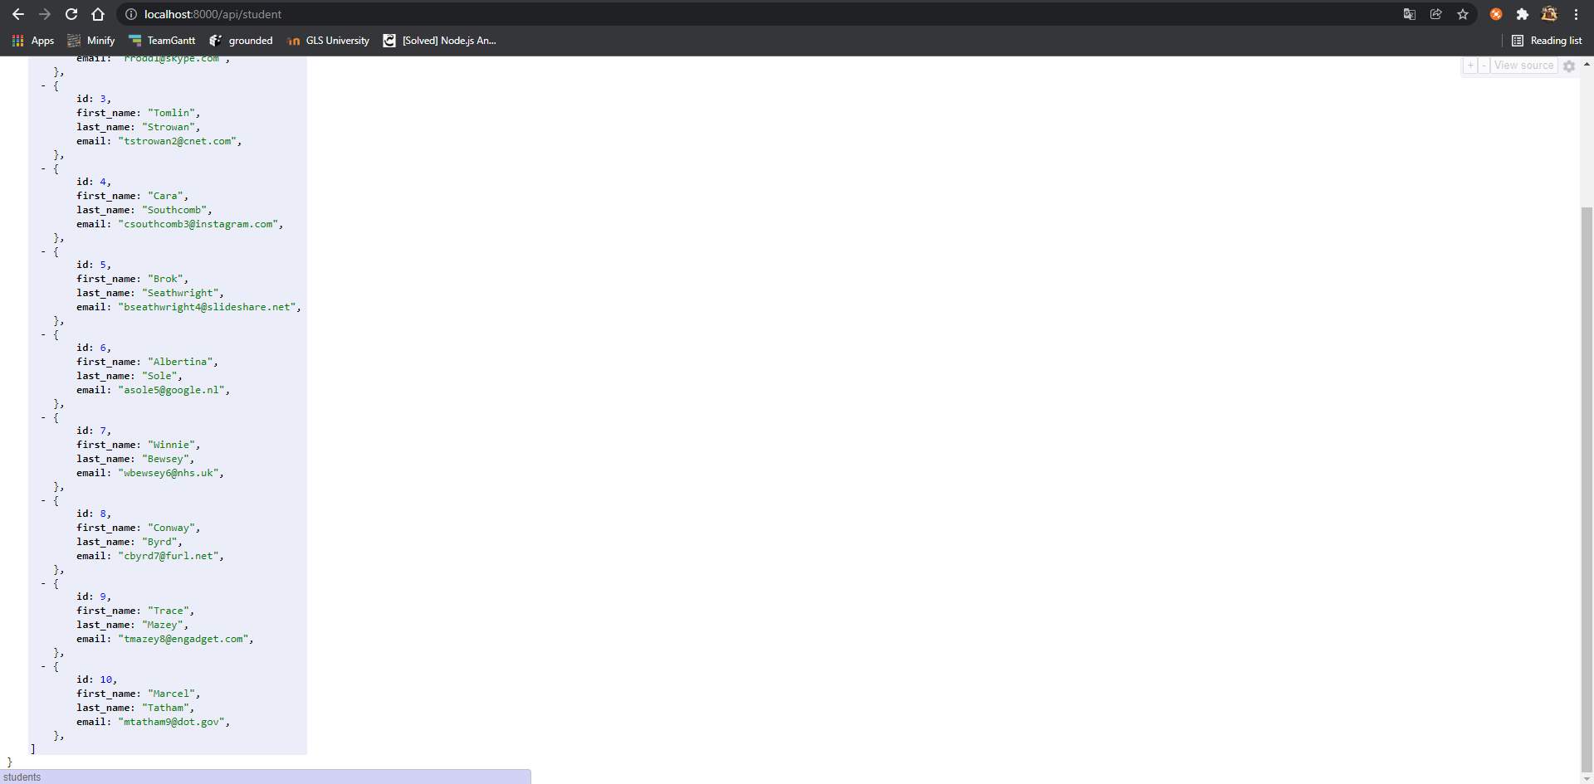
File Storage System:
DELETE API's student using

Slide 13
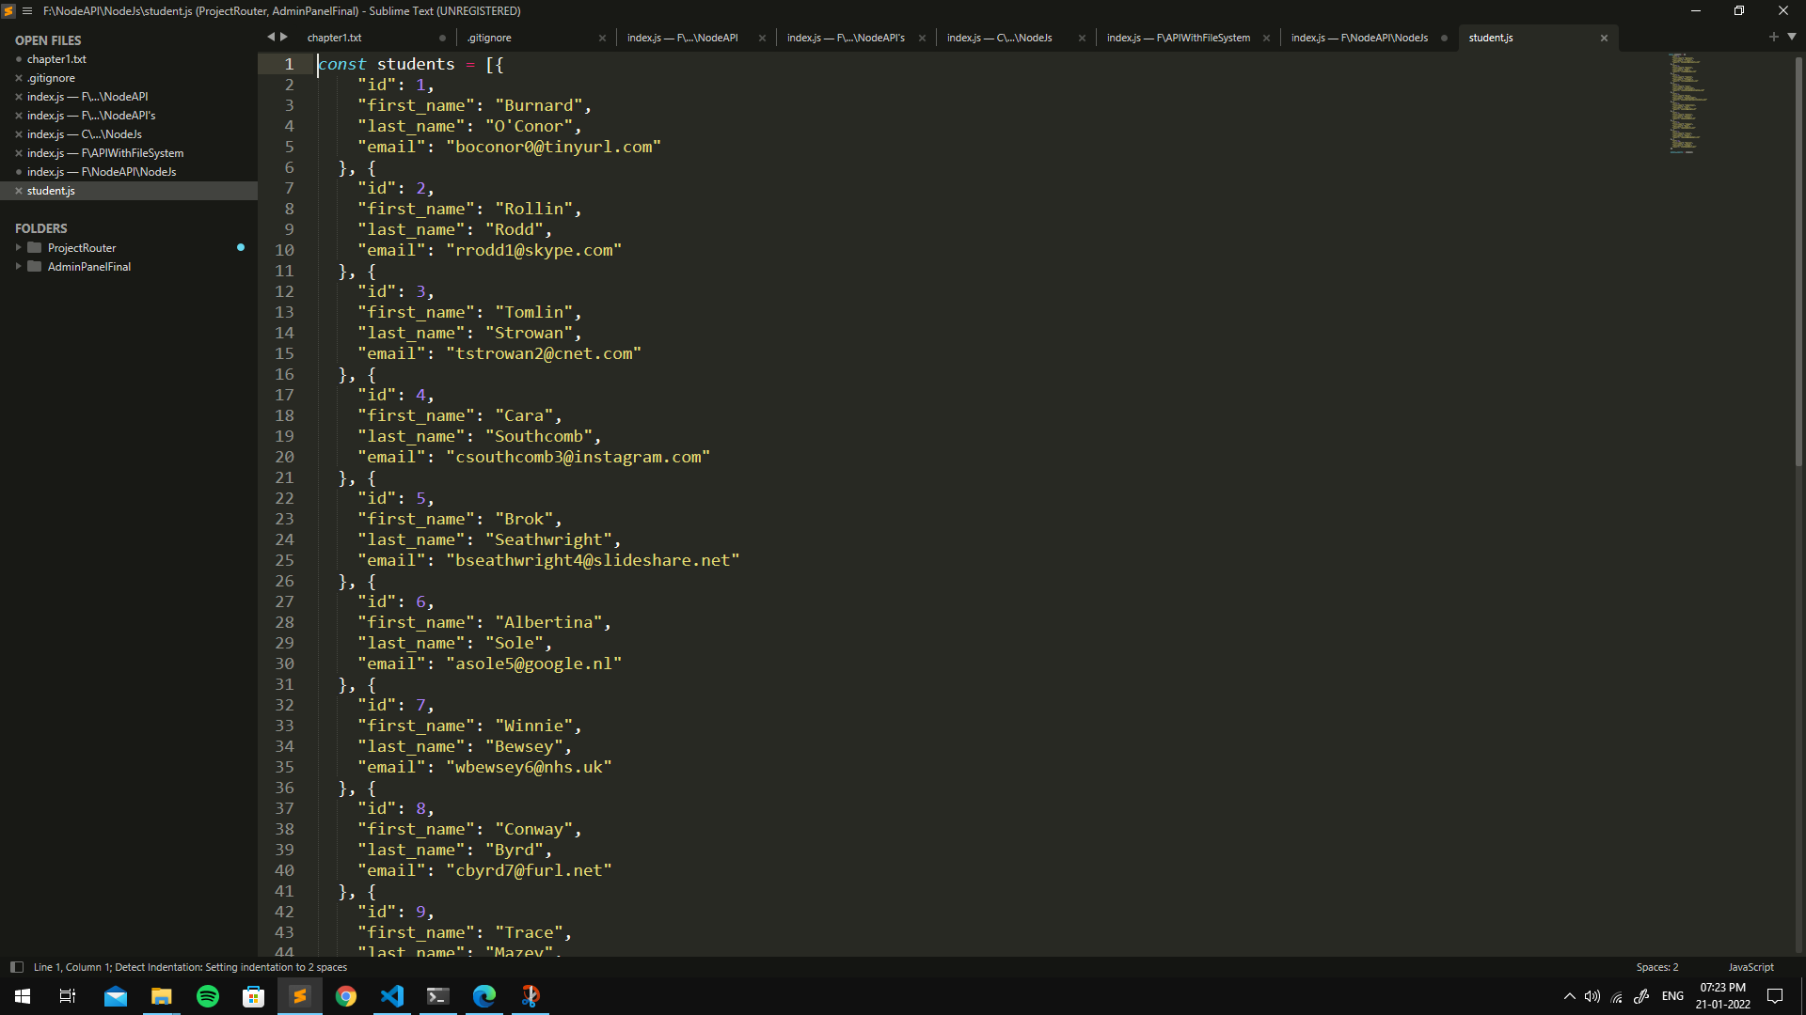
File Storage System:
A file which contains data of student objects in JSON format..

Slide 14
Connection with MongoDB
Now After file storage try to connect DB with Node JS API's.
Installing MongoDB compass on machine
Documentation reading & firing basic queries on cli.
Understanding of mongo DB compass.

Slide 15
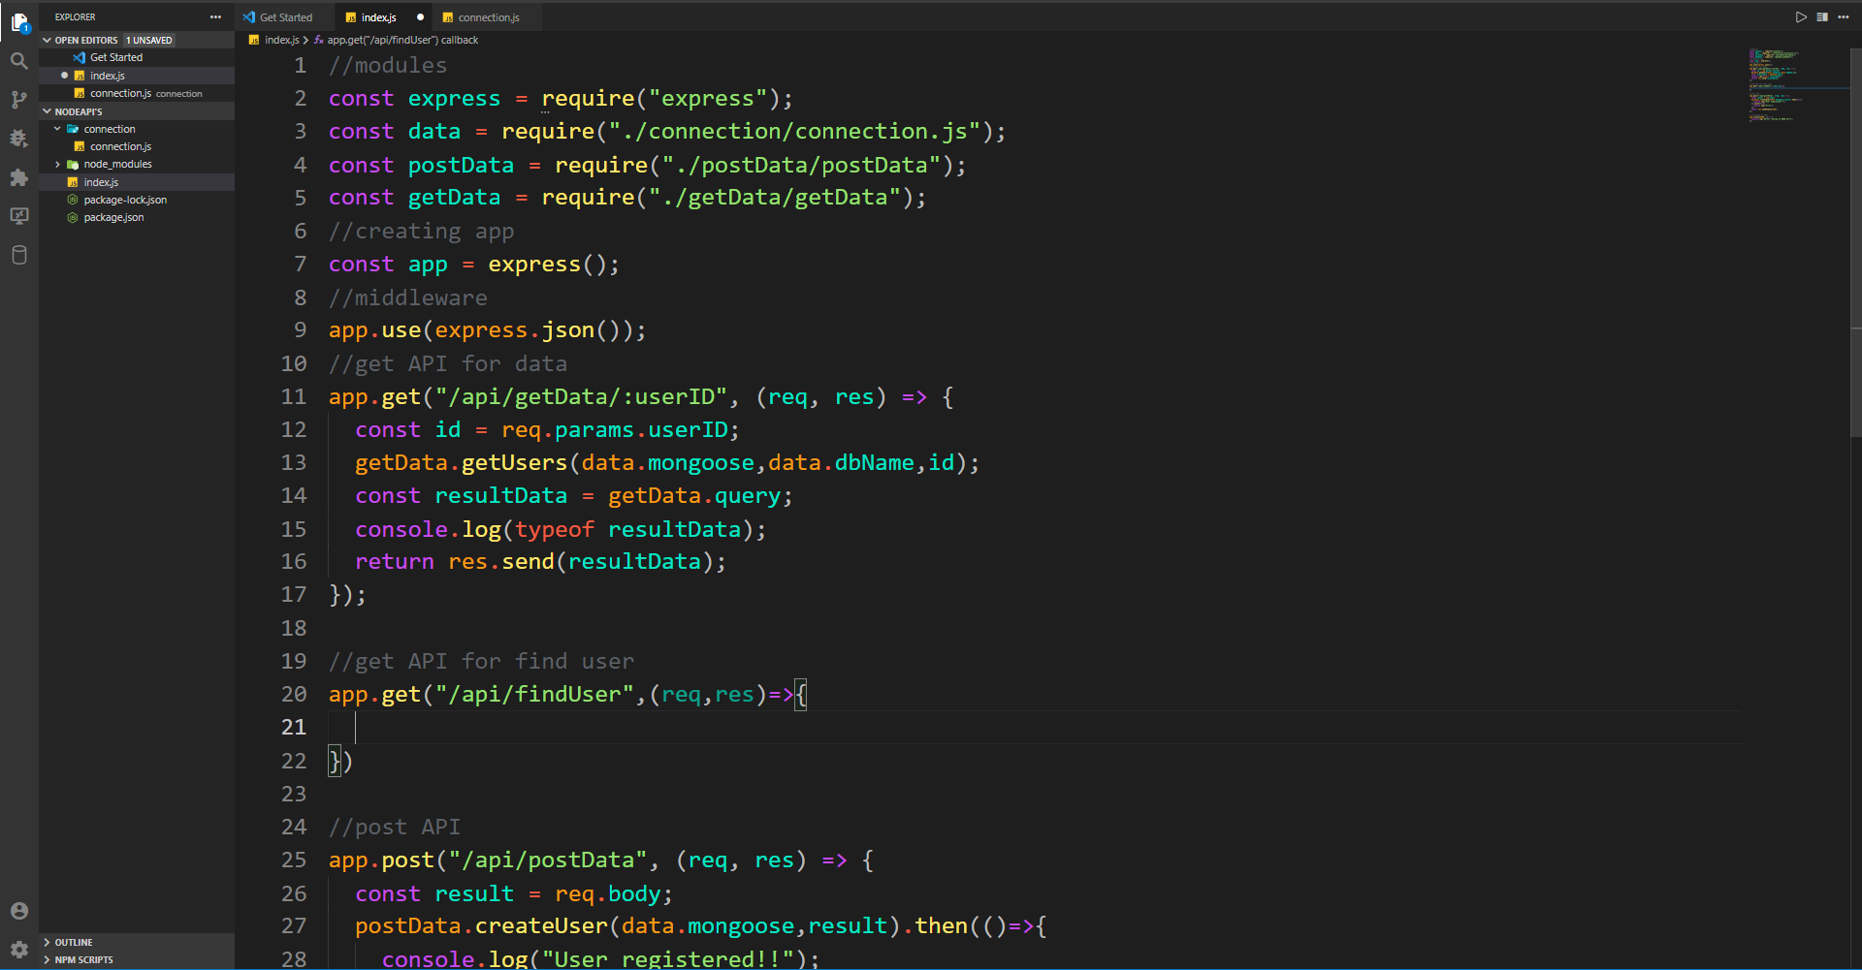
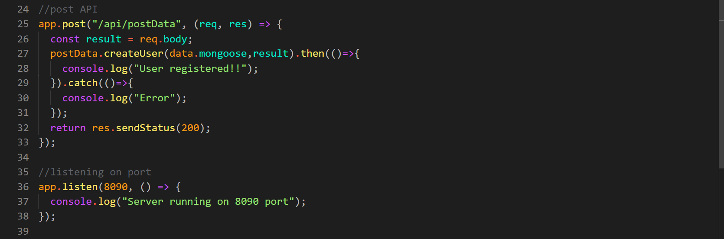
Connection with database:
This Api's contain major two crud operations
1) Get Data from DB
2) Post Data to DB

Slide 16
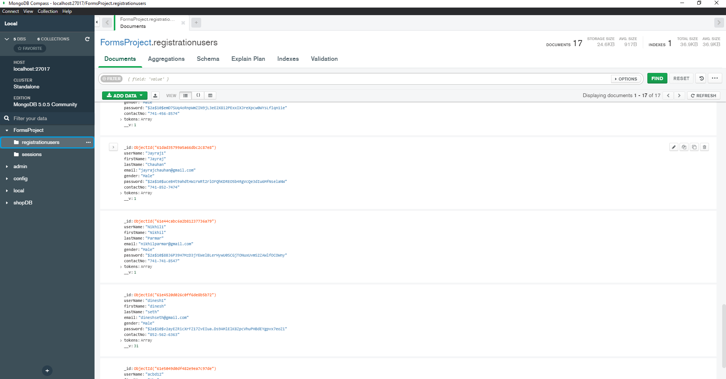
Mongo Db compass
Here you can see multiple objects of user has been created using post api and stored into database

Slide 17
MEAN Stack Project
From now we are using POSTMAN tool to call api for request and response from users.
Try to create basic crud operation app using Angular, Node JS, Express JS and Mongo DB.
This project also contains CRUD operations, User authentication, validations, MVC structure, dev-dependencies, middleware's, cors etc.

Slide 18
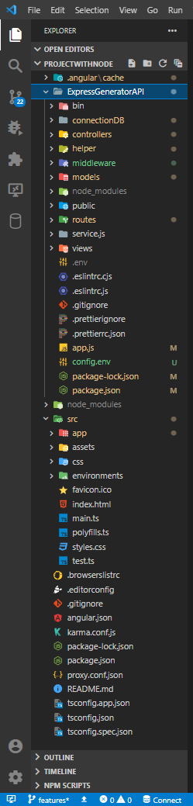
File structure which contains:
Angular CLI
Express generator API
Git-ignore files
Env files
Vs-code extensions:
ES-lint
Spell-checker
Prettier
Angular:
Bootstrap css
Components
Cors
App.service.ts

Slide 19
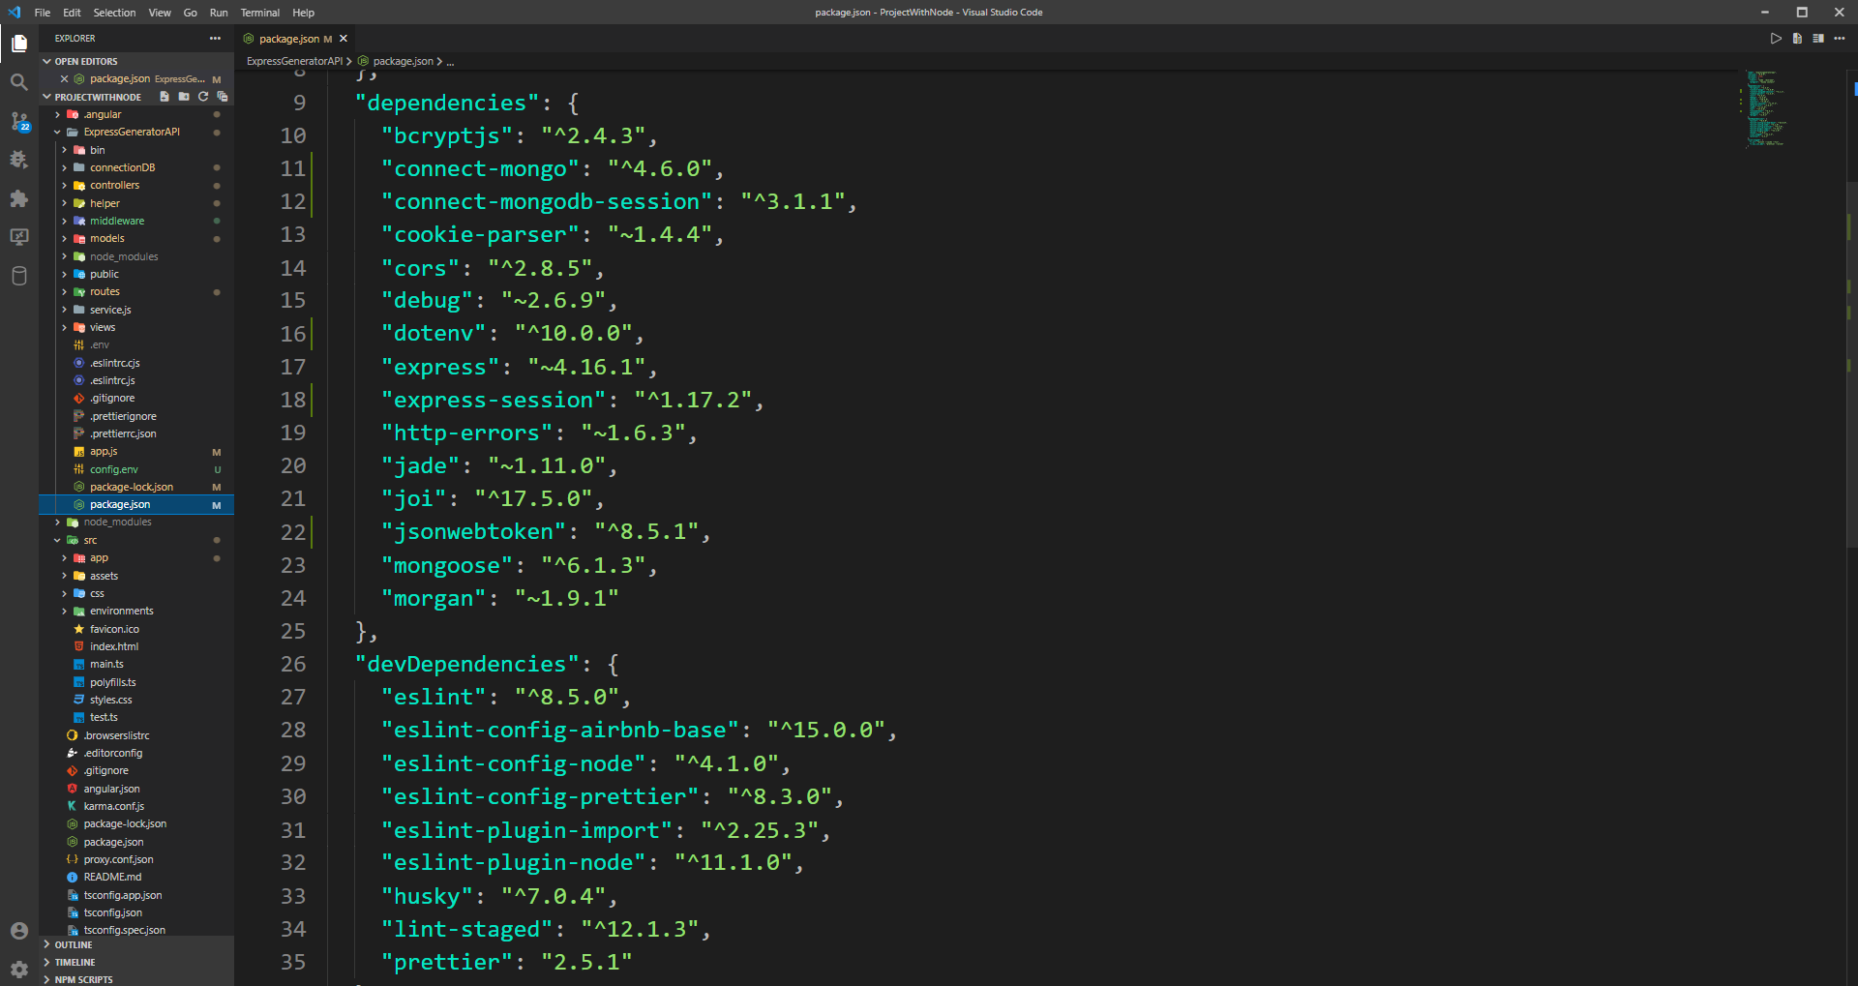
Dependencies & devDependencies using into project
Package.json file contains all this dependencies

Slide 20
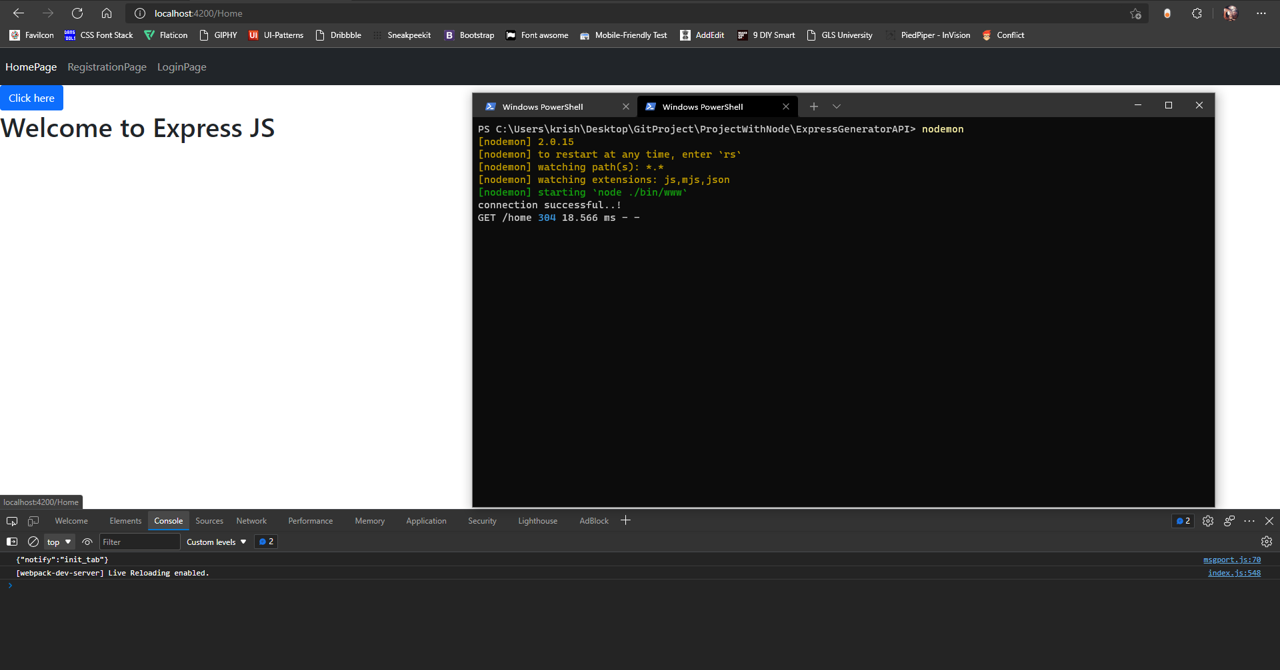
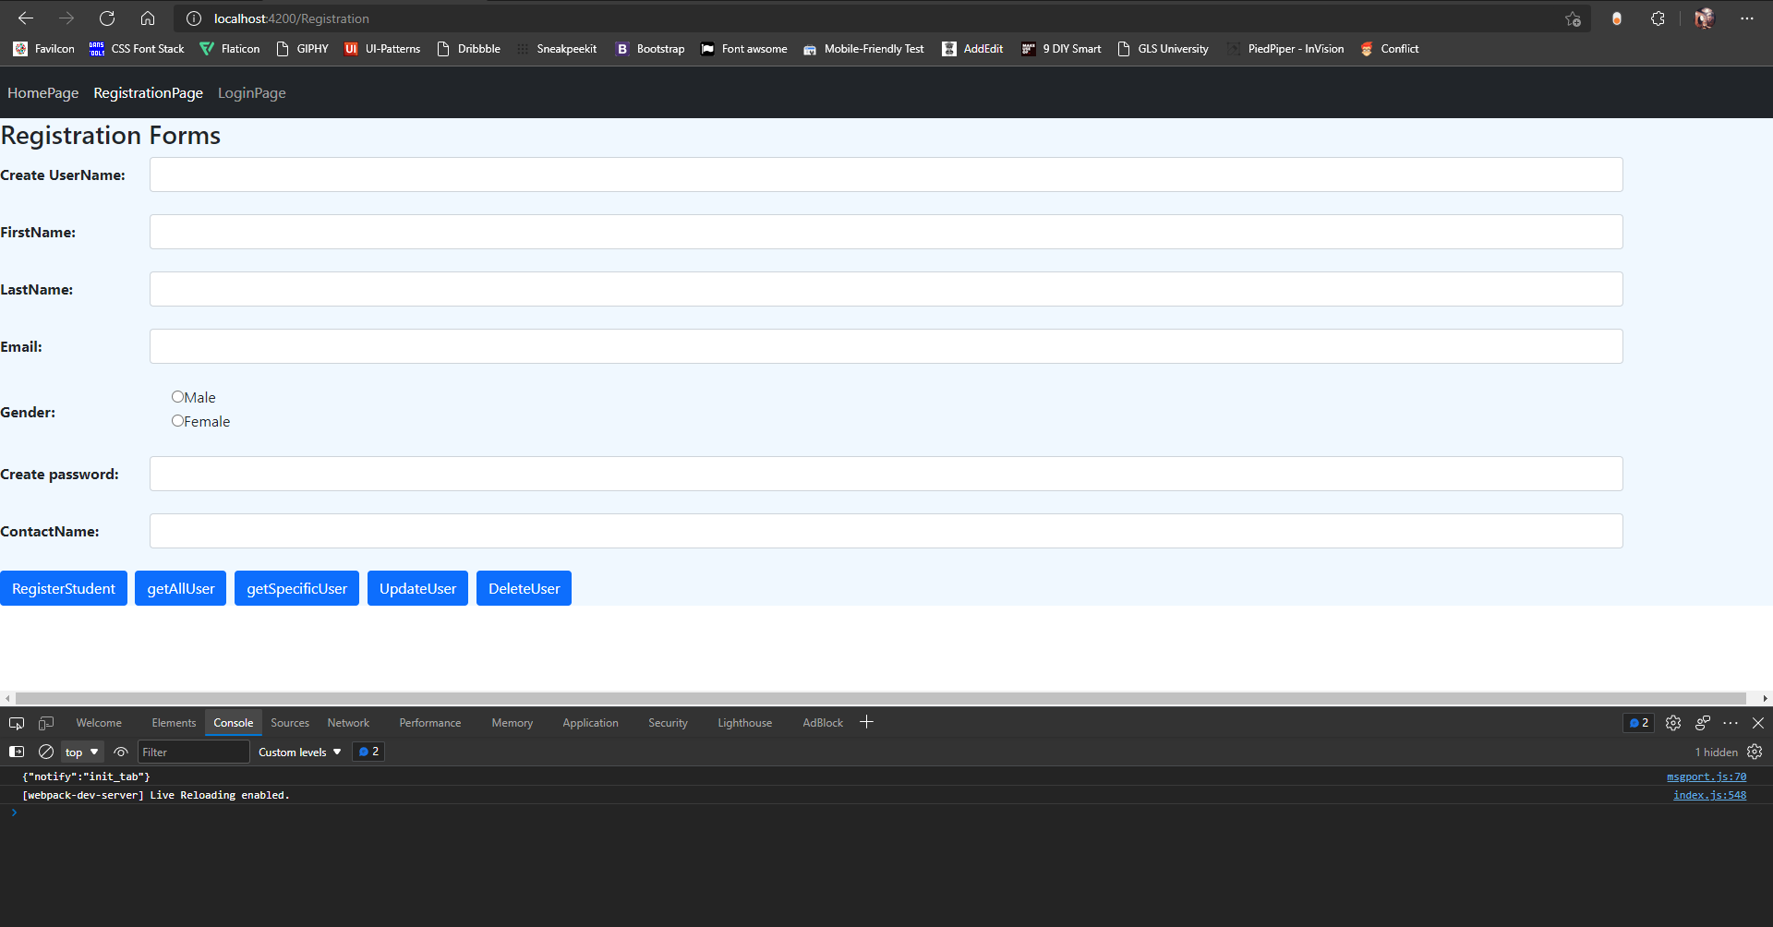
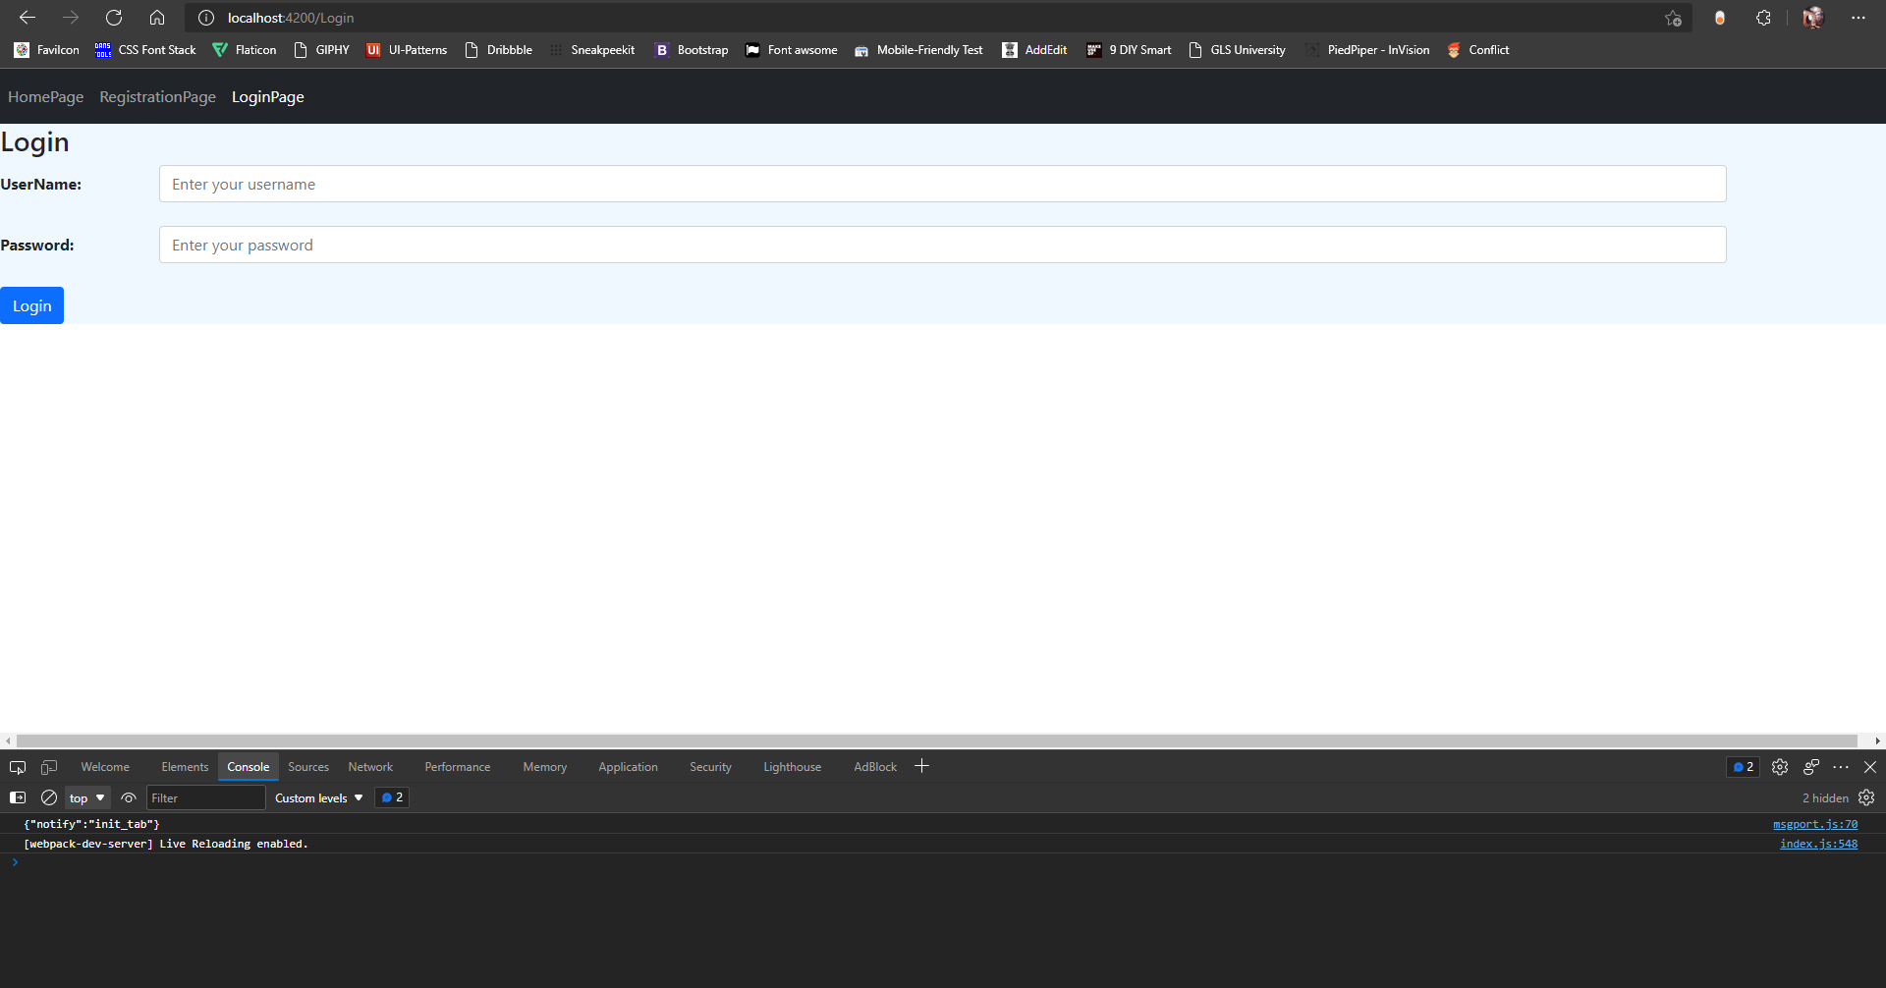
GUI Screens from Angular

Slide 21
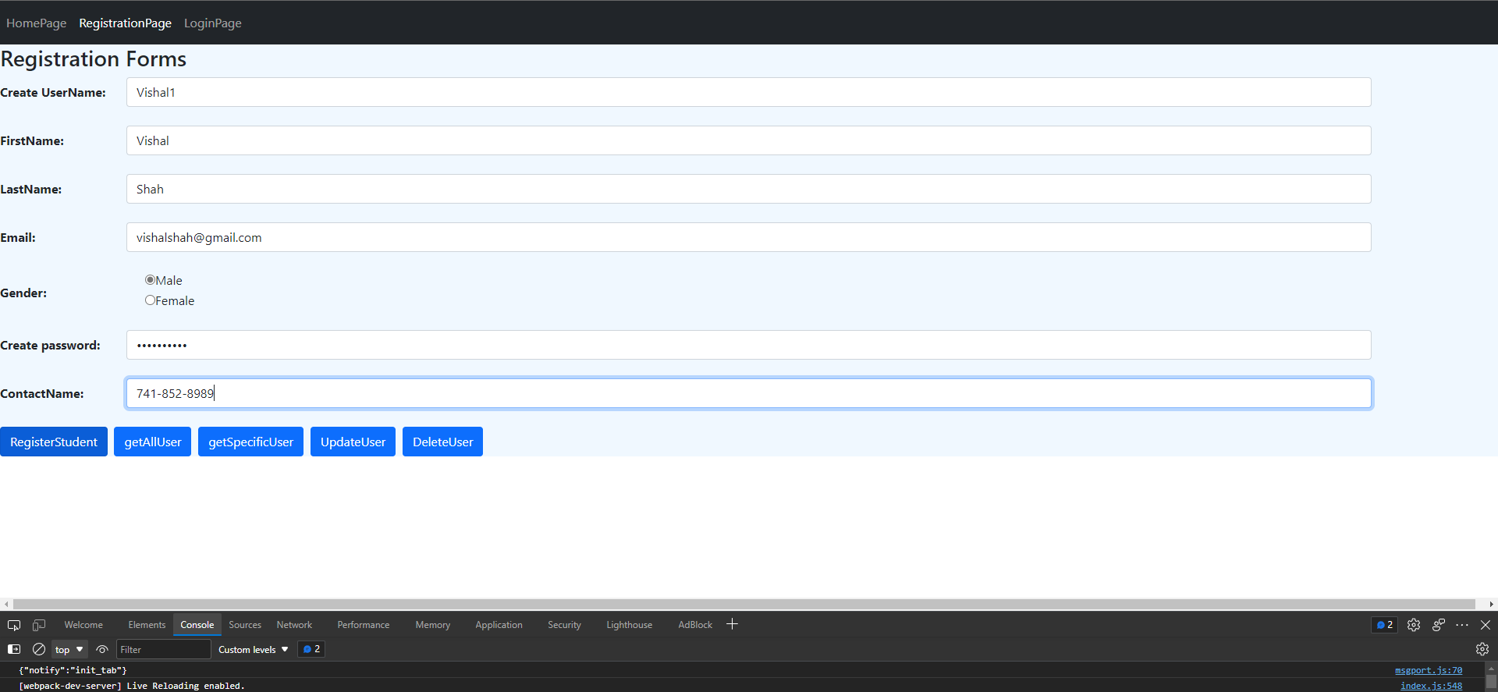
User Registration details..

Slide 22
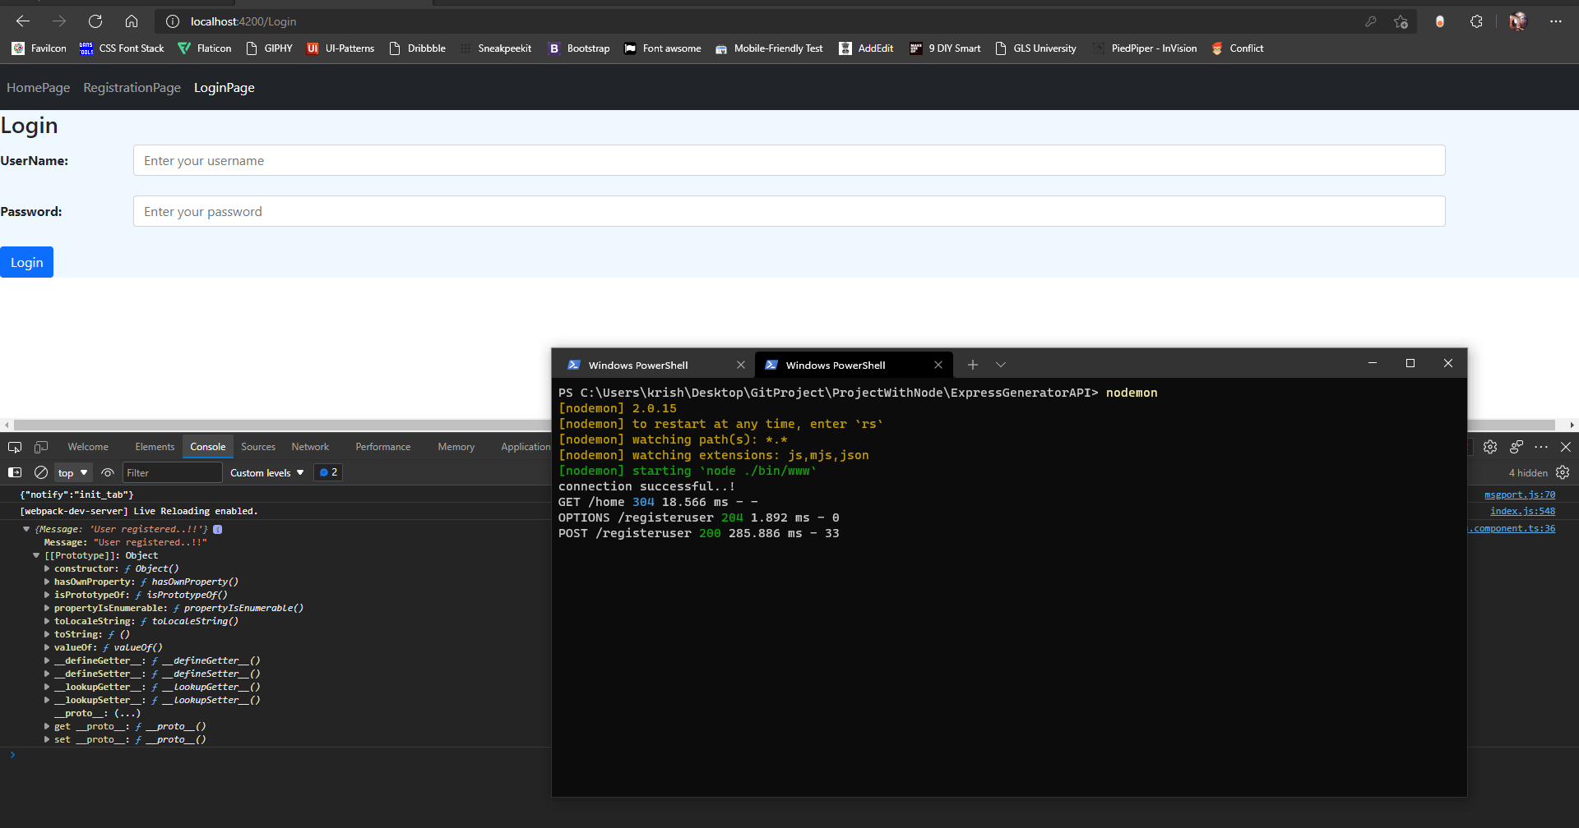
Registration Page
Whenever user register successfully page redirected to login page

Slide 23
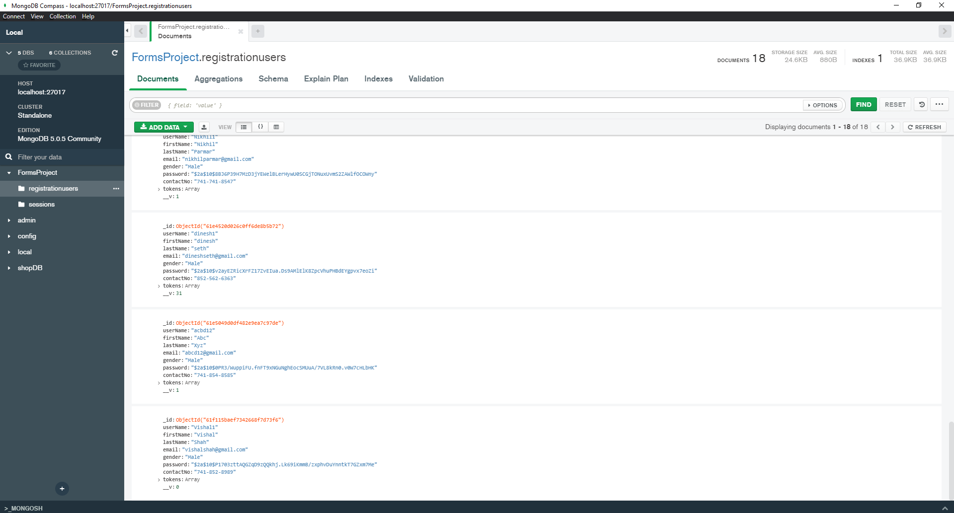
User registered data in mongoDb compass

Slide 24
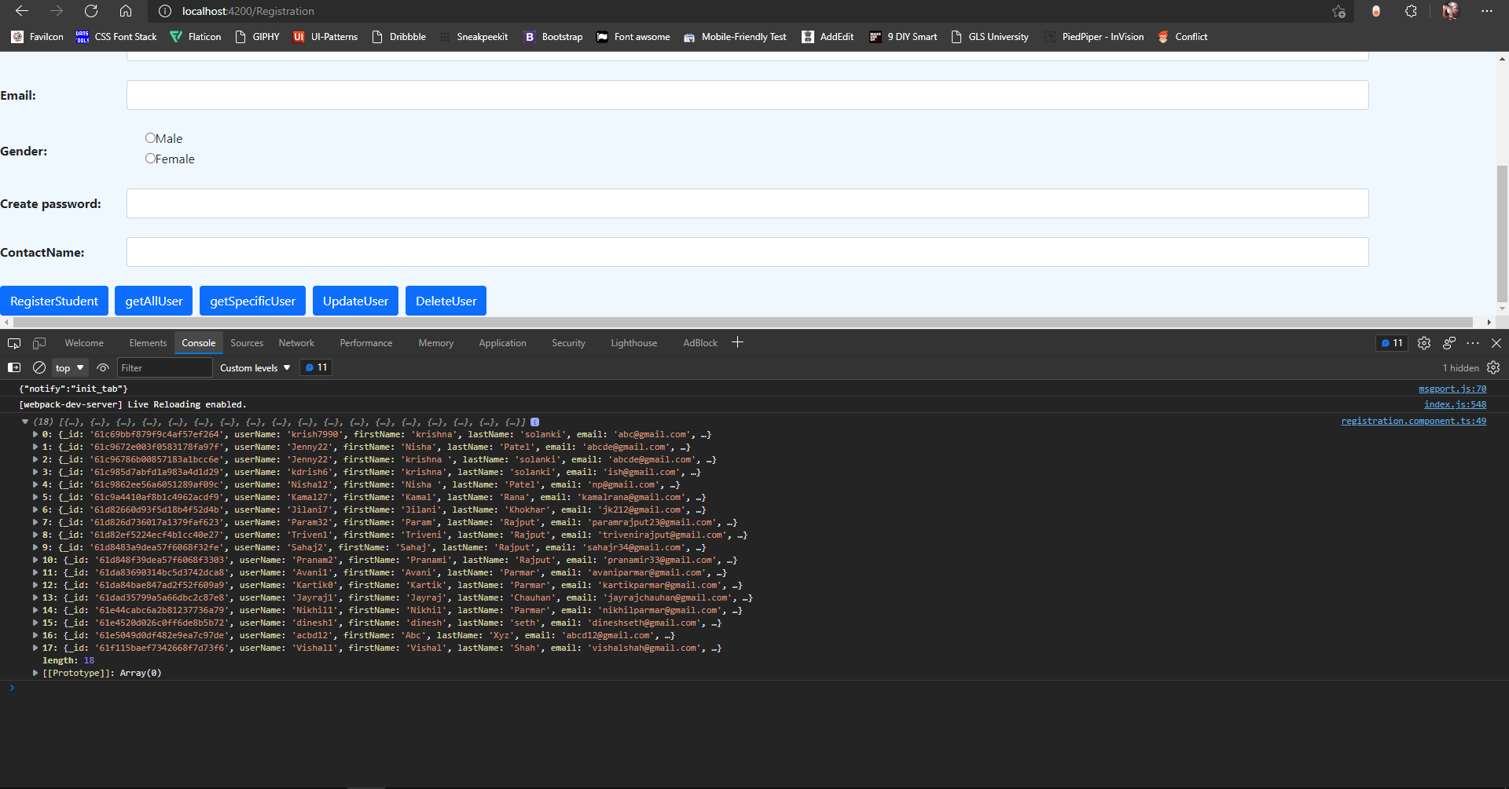
Registration Page
GetAllUser API's

Slide 25
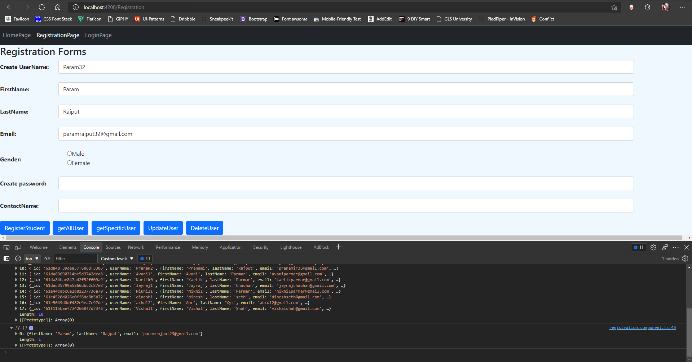
Registration Page
GetSpecificUser API's

Slide 26
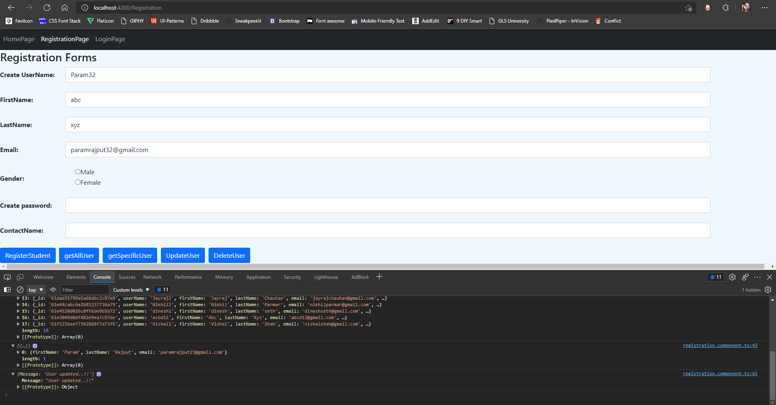
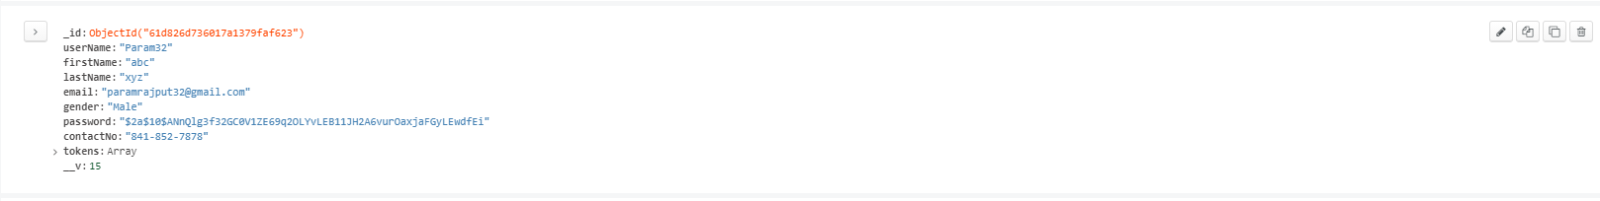
Registration Page
Update user via username & response from user

Slide 27
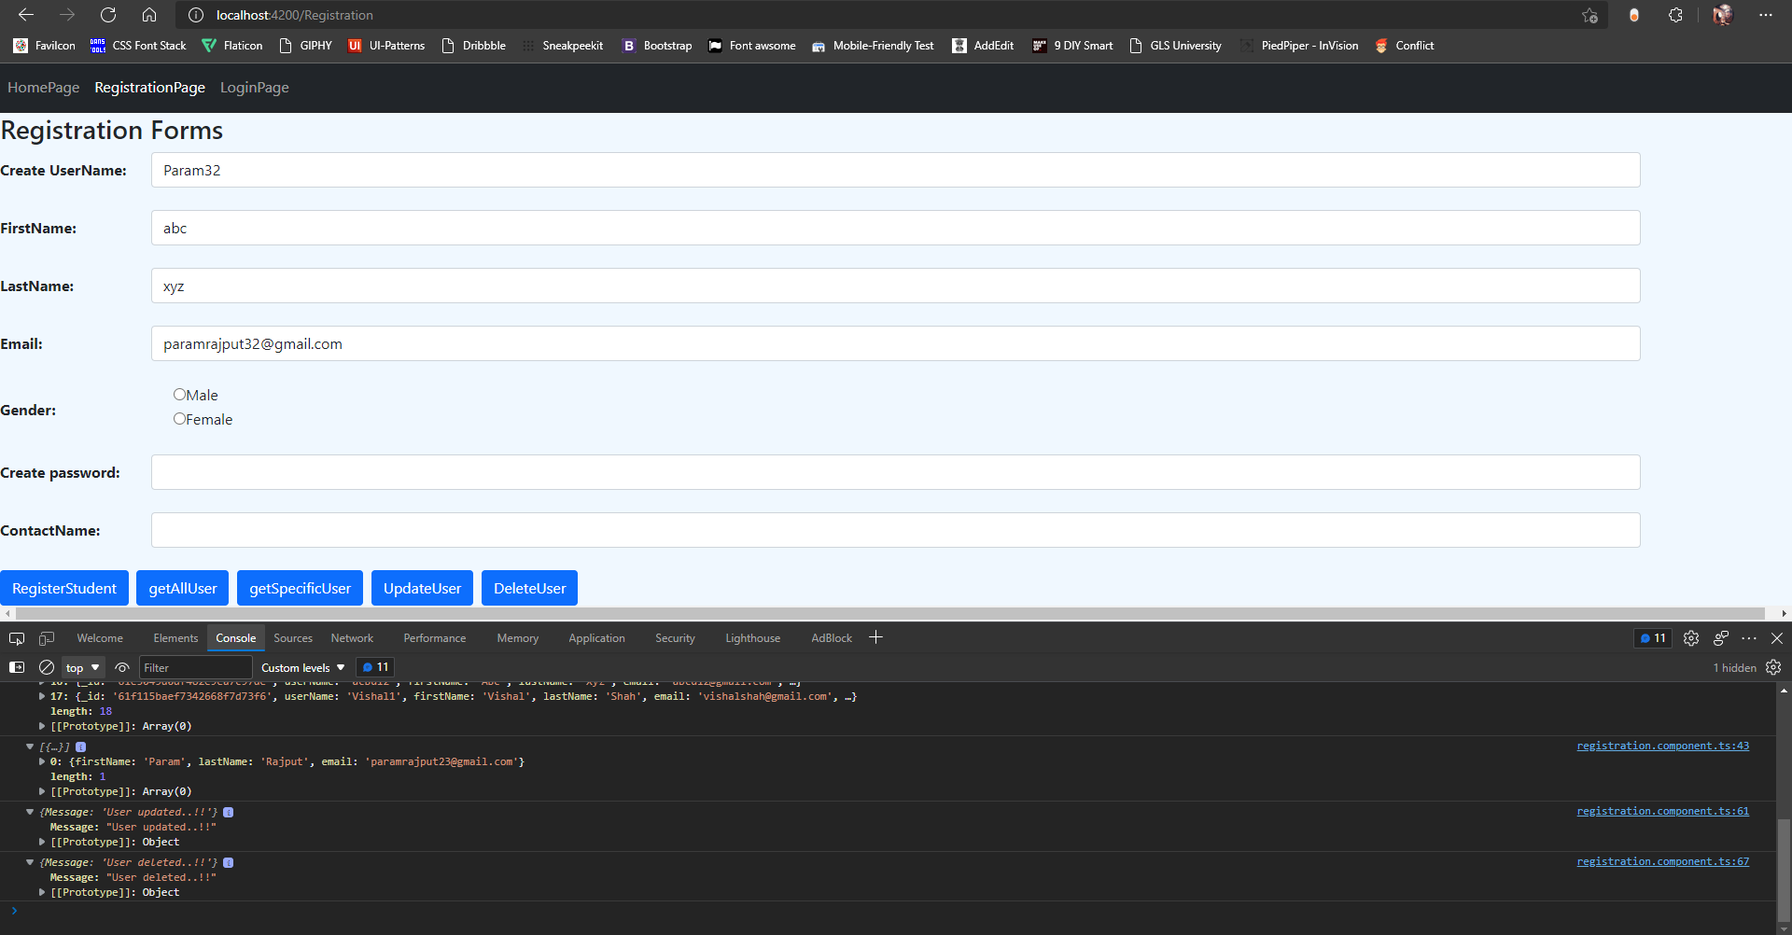
Registration Page
Delete user by userName..

Slide 28
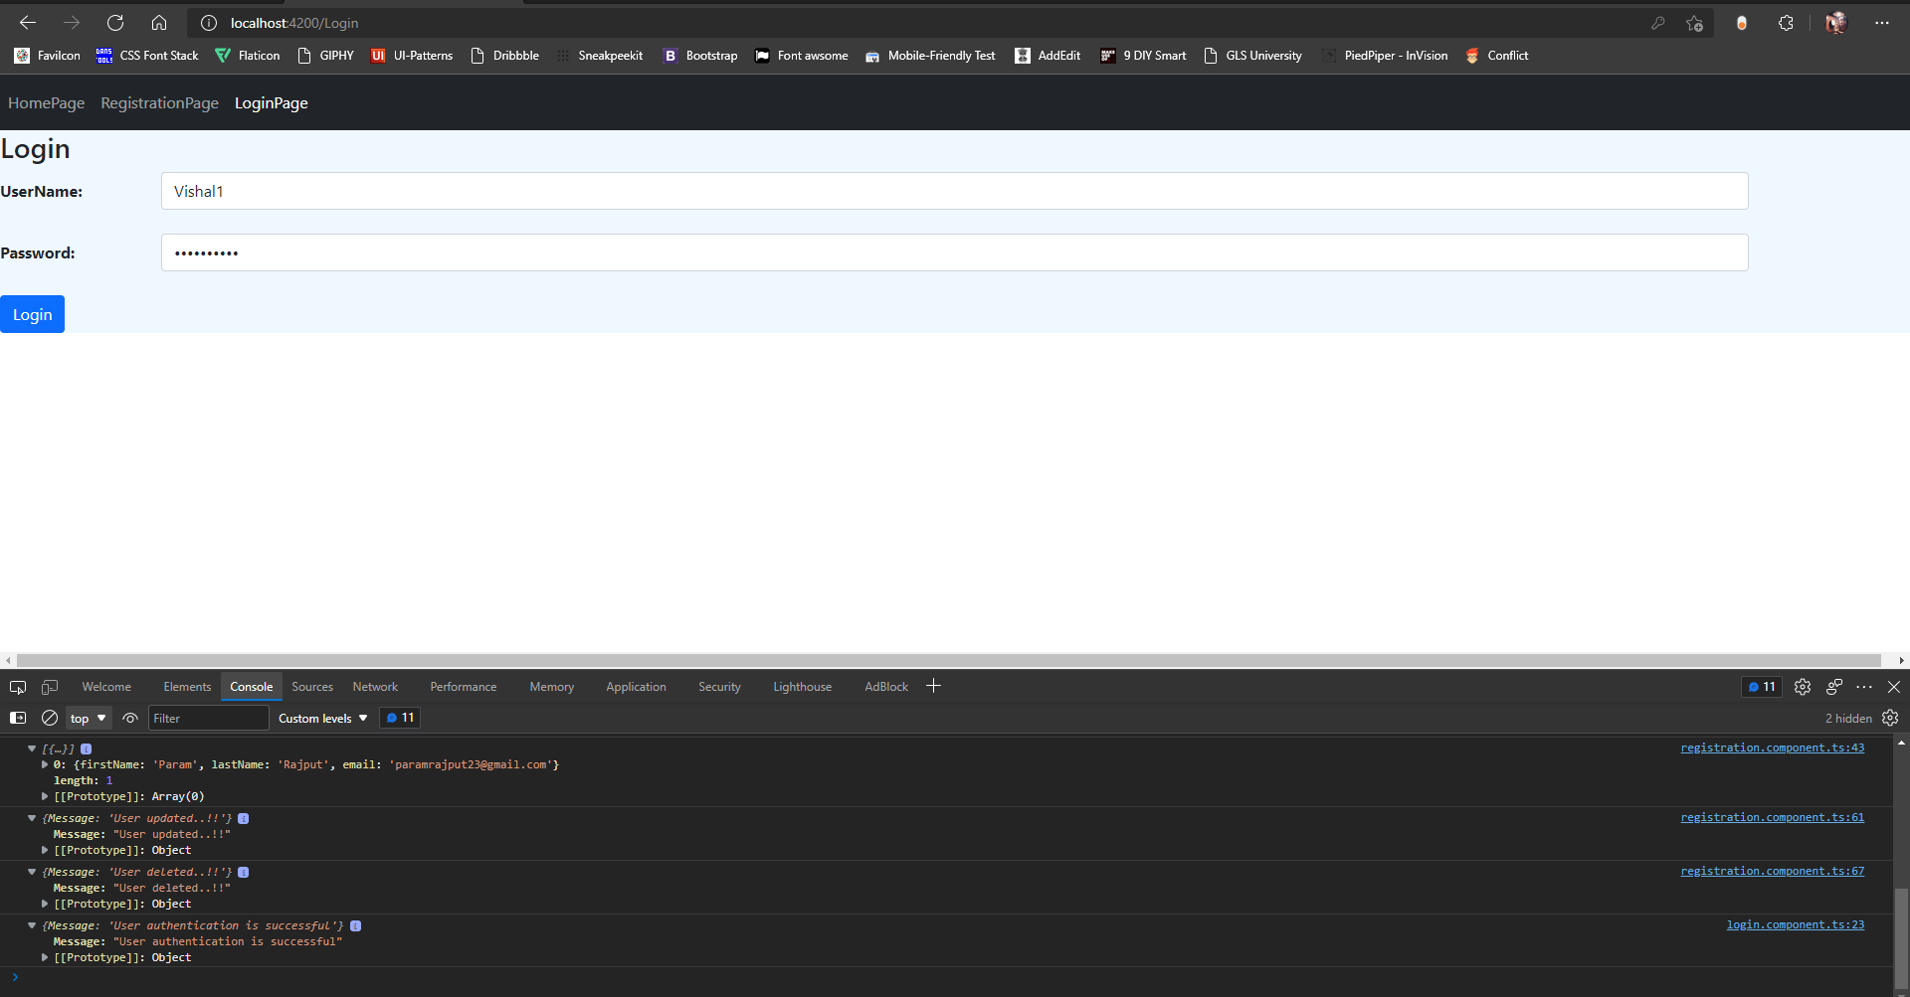
Login Page
When user login with correct credetials it will show you response from server side..

Slide 29
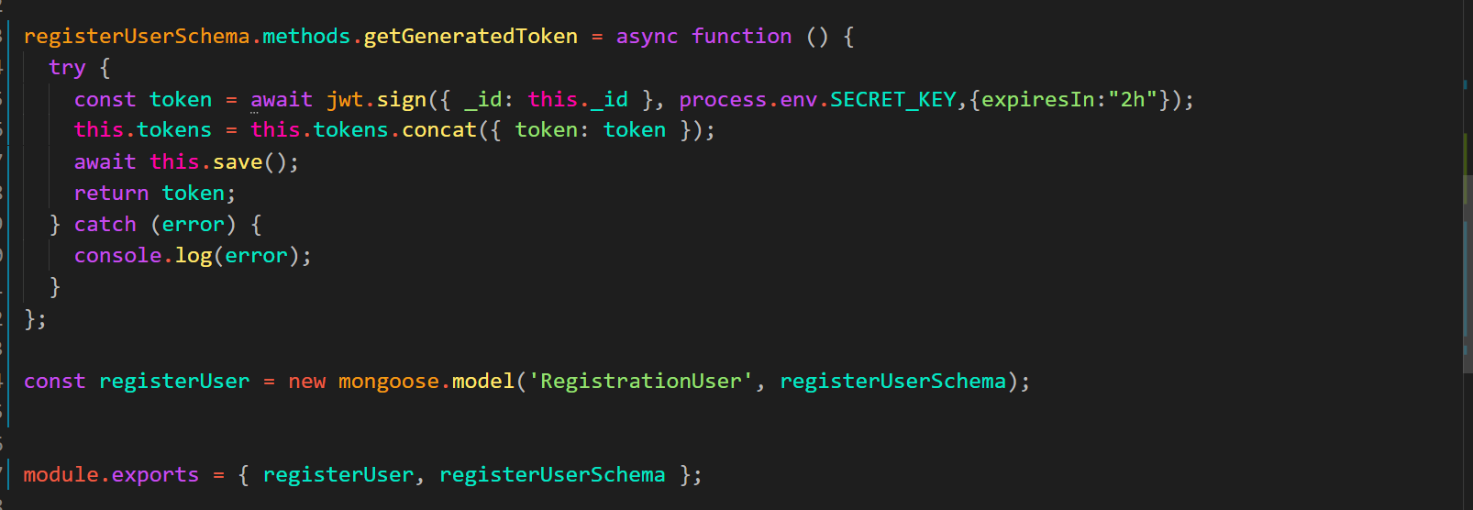
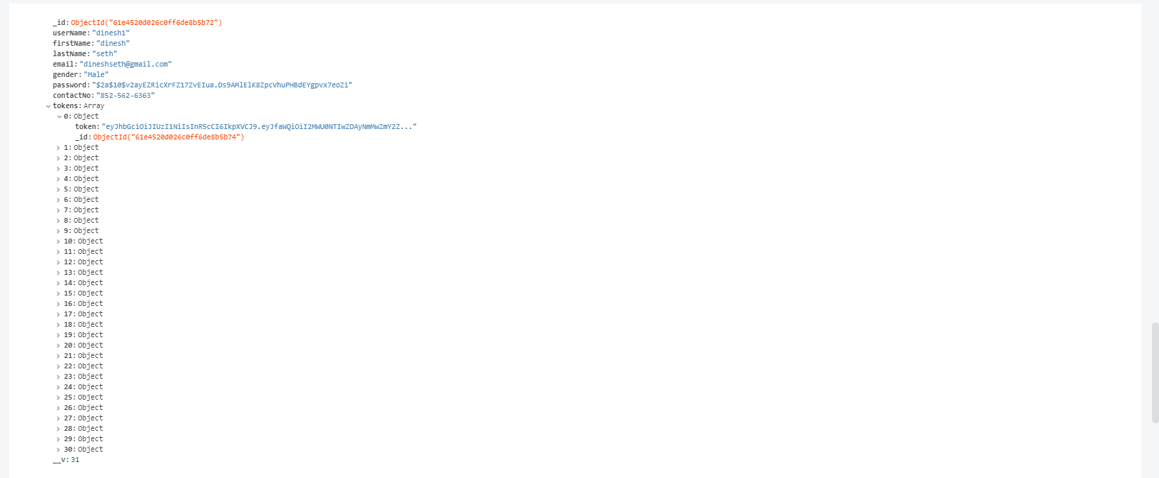
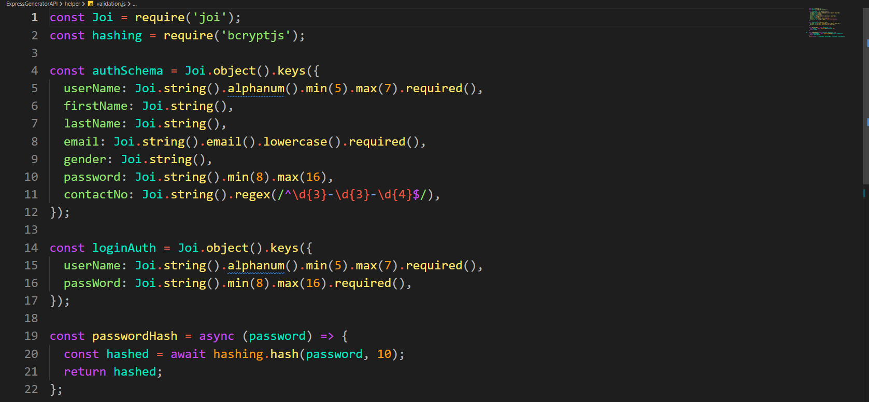
Also generating tokens and saved into db for authentication on every apis
Server sided validations on express JS using 'joi' npm packages.

Slide 30
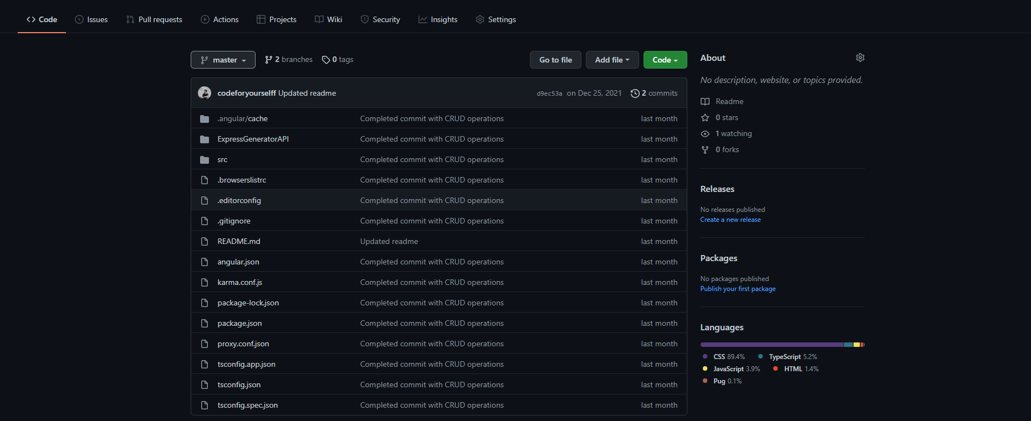
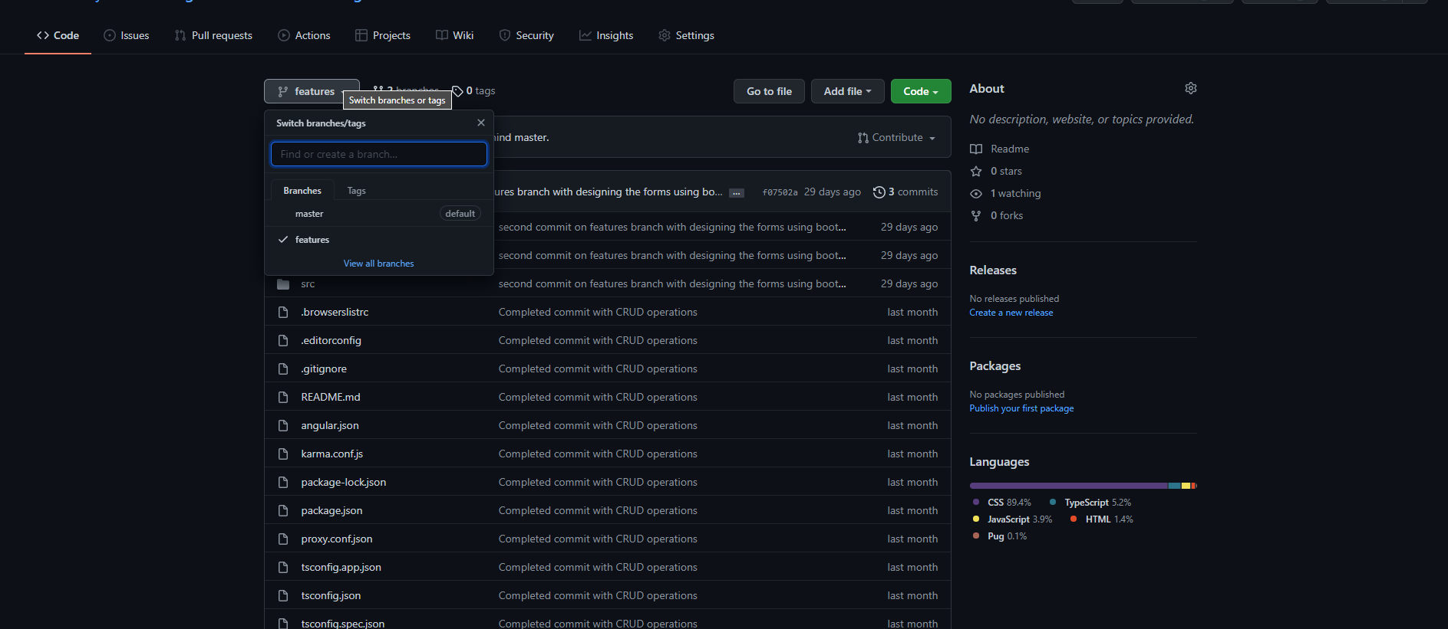
Git and Git-hub
Project uploaded on GitHub using git
Created total 2 branches
Master
Features(updated code was uploaded on this branch)
git@github.com:codeforyourselff/AngularWithNodeAndMongoDB.git

Slide 31
Industries internship
Tech assigned: Angular, dotnet
Programming languages: Html, CSS , JavaScript , jQuery , c#
Induction lectures contains only privacy and policies about companies

Slide 32
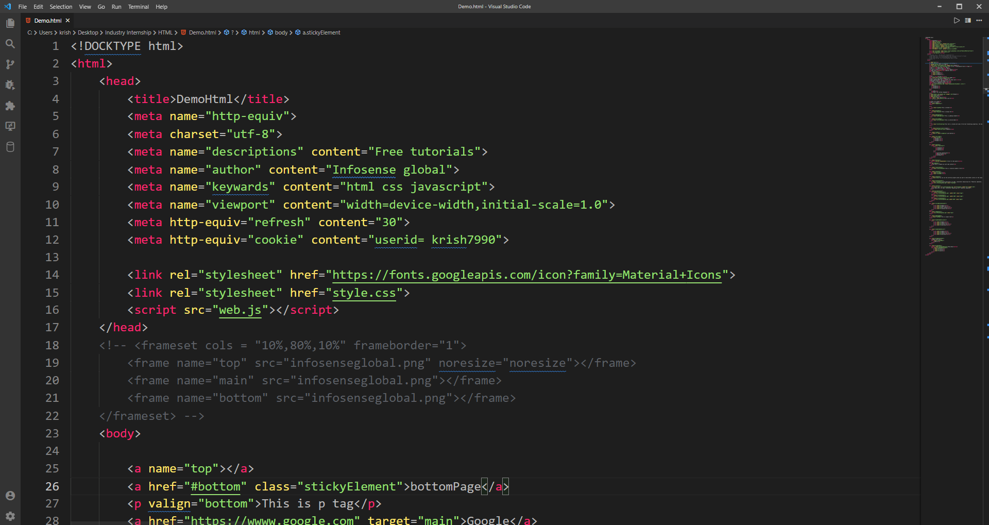
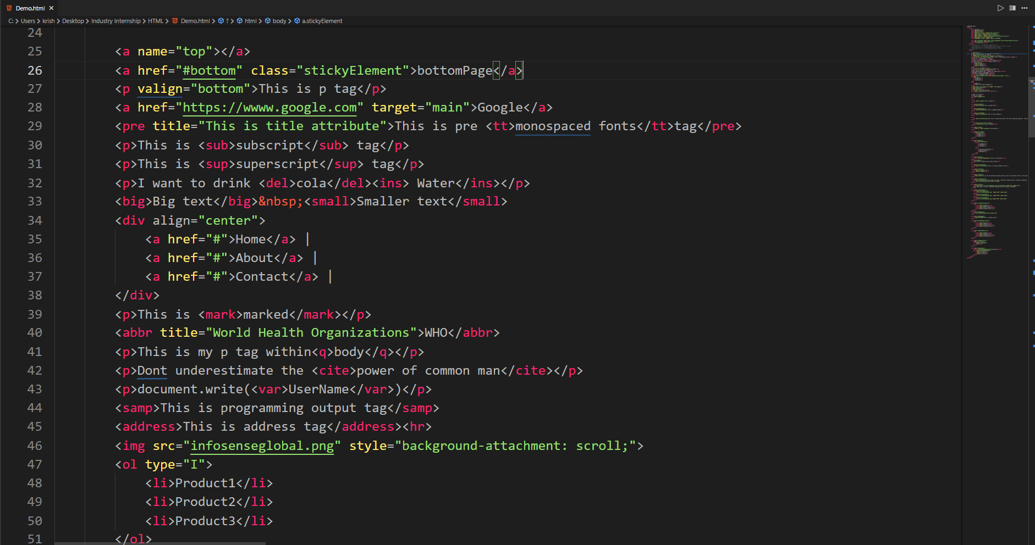
HTML Basics
Learn all html 5 basic tags & practice it from w3schools.com

Slide 33
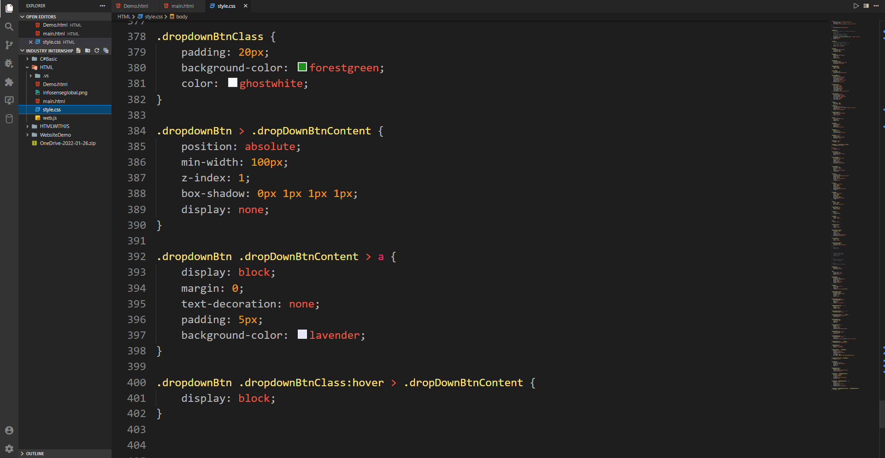
CSS practice

Slide 34
JavaScript Tasks
Completed basic JS from tutorials point.
Completed given task.
Pattern
Calculator
Form

Slide 35
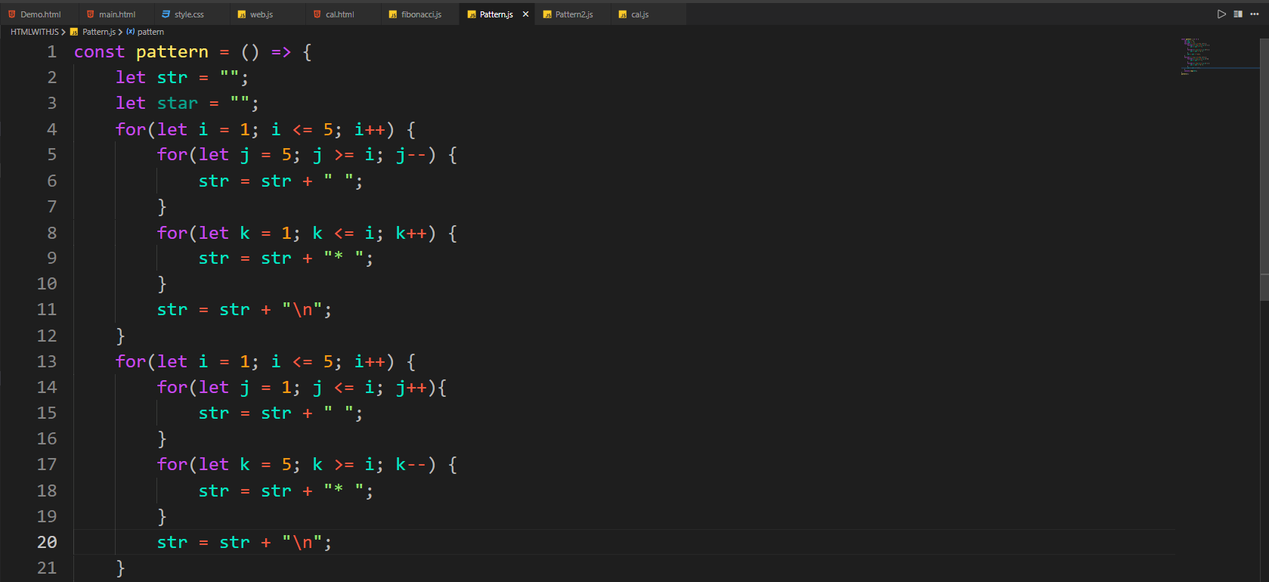
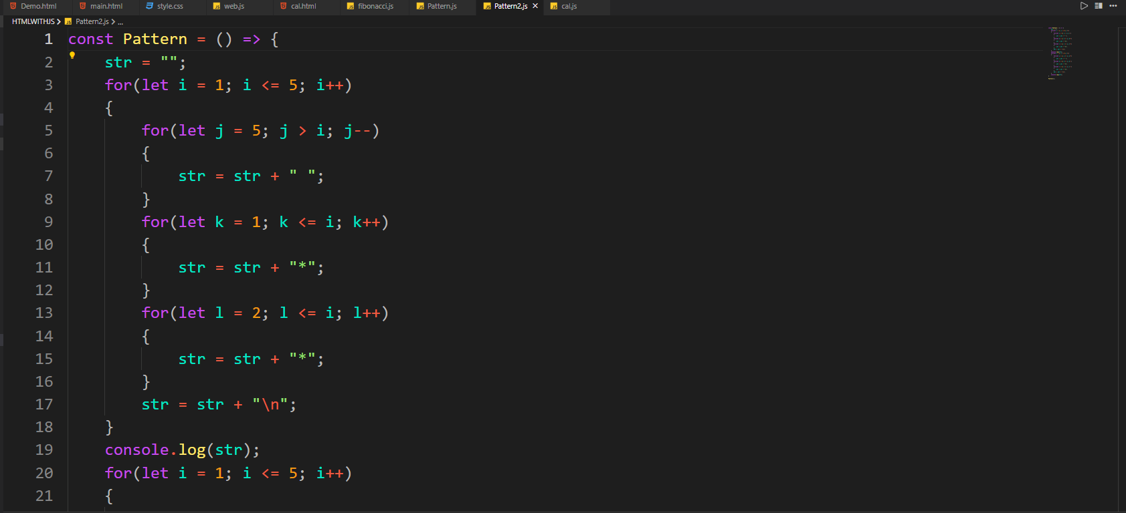
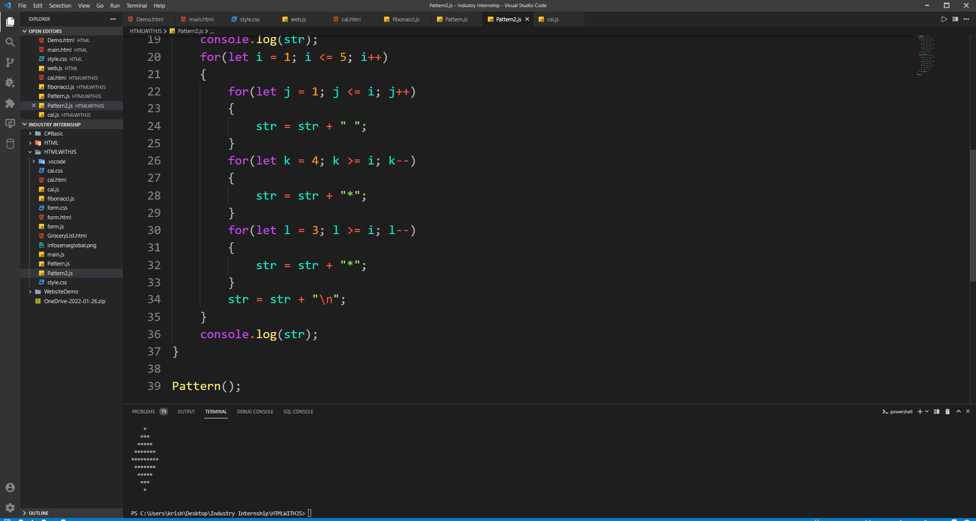

Slide 36
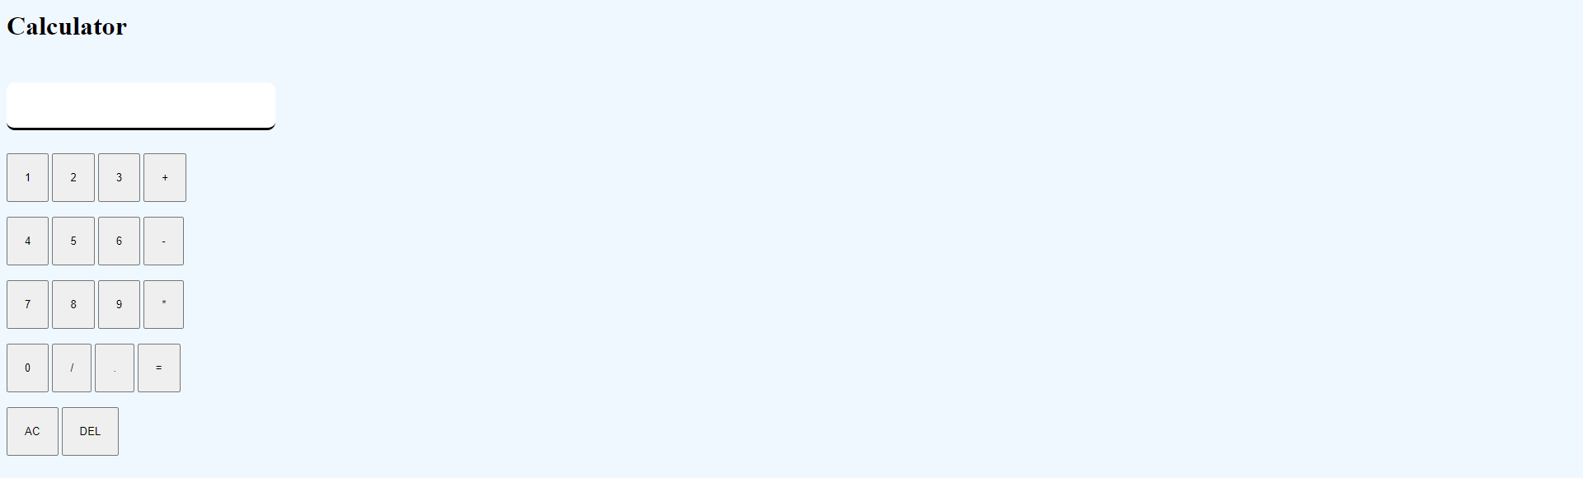
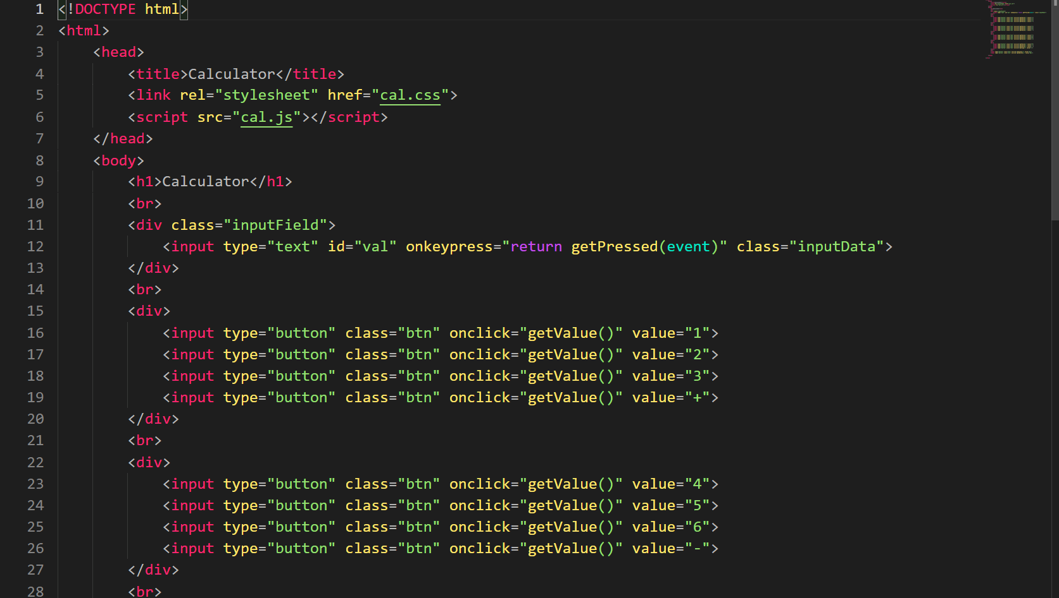
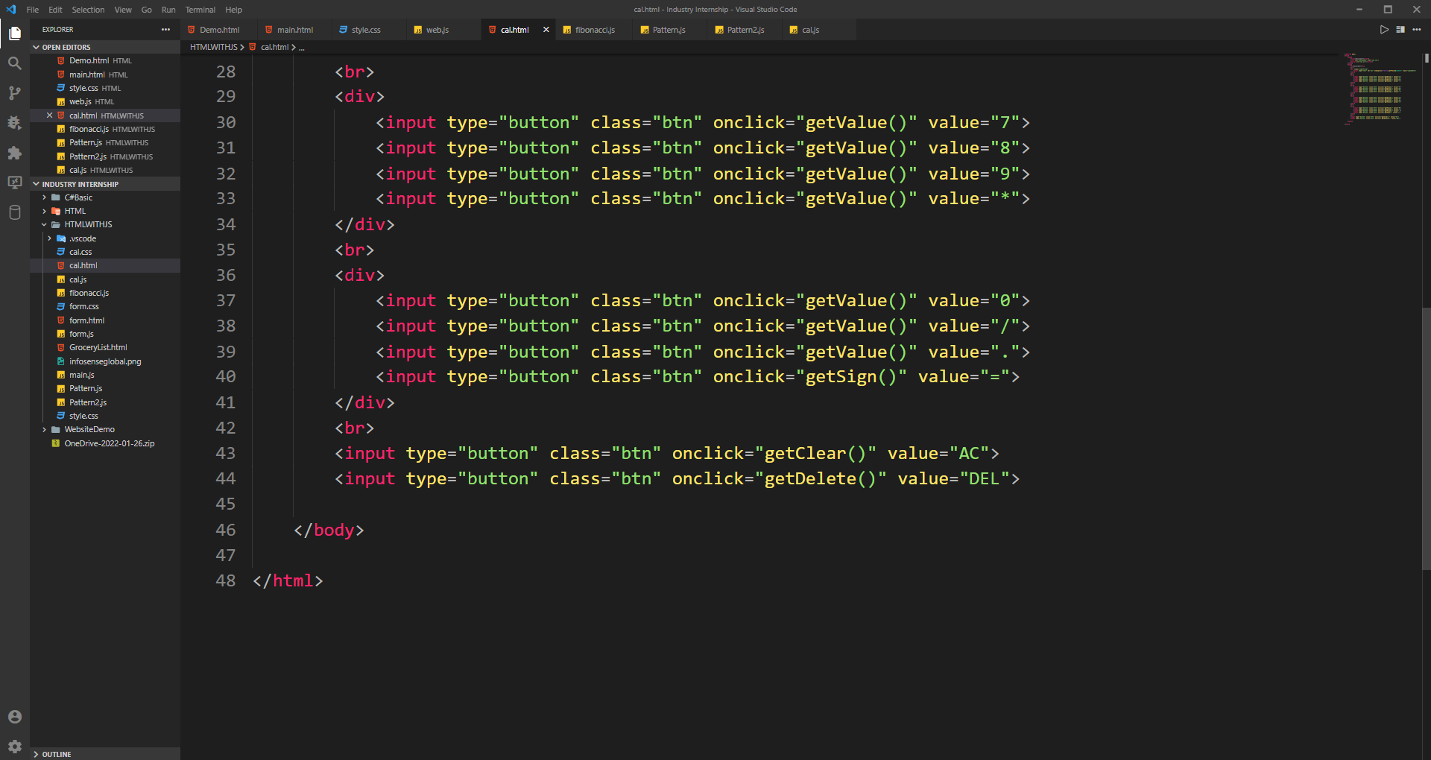
Calculator

Slide 37
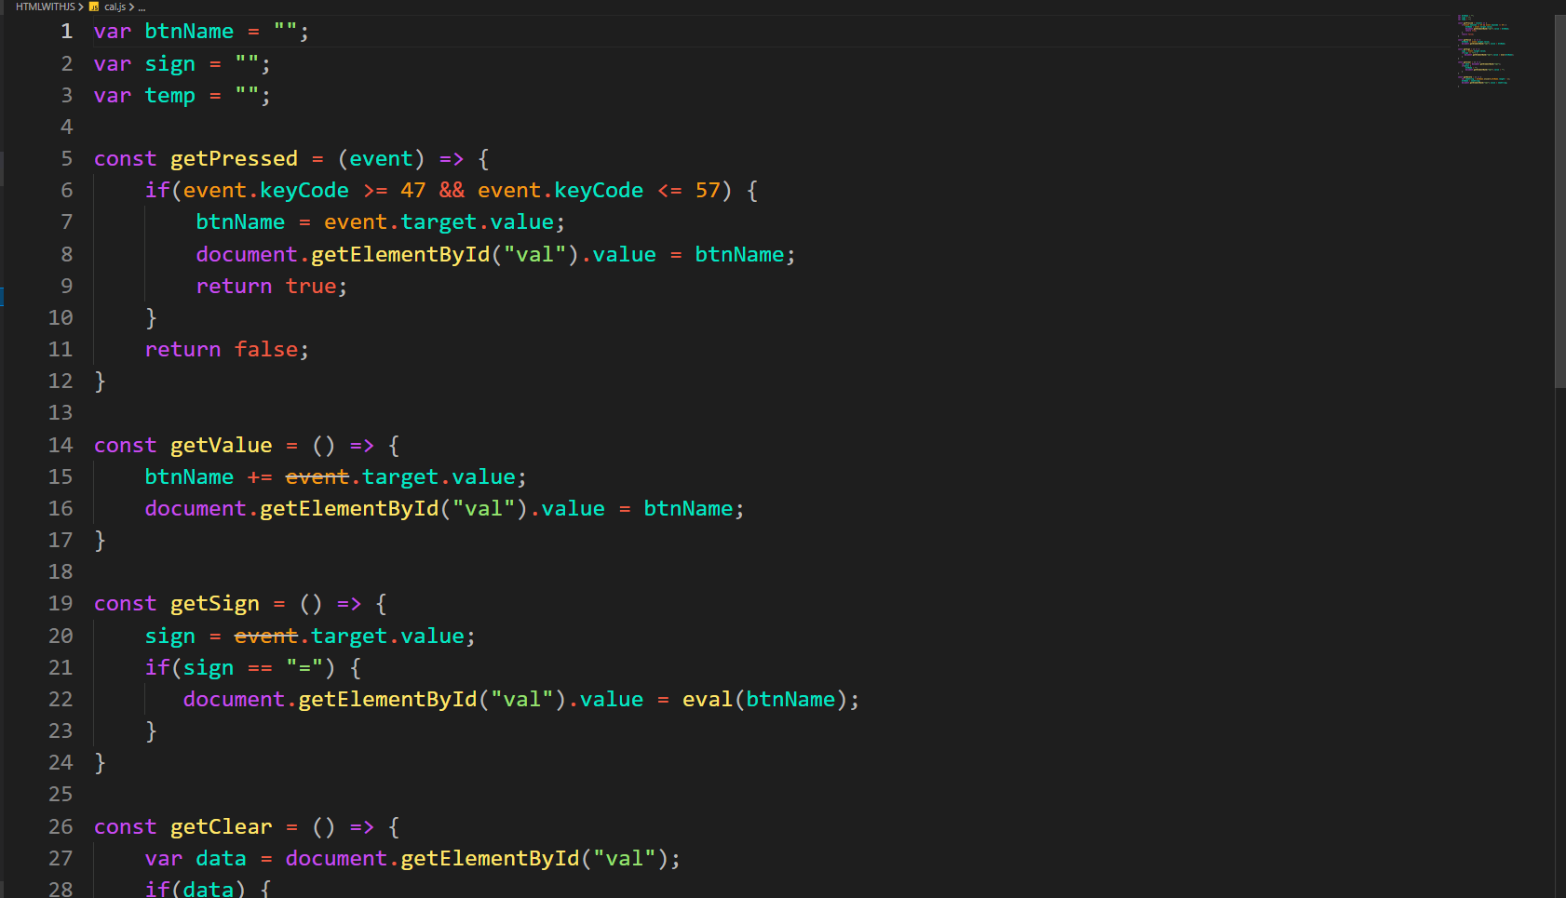
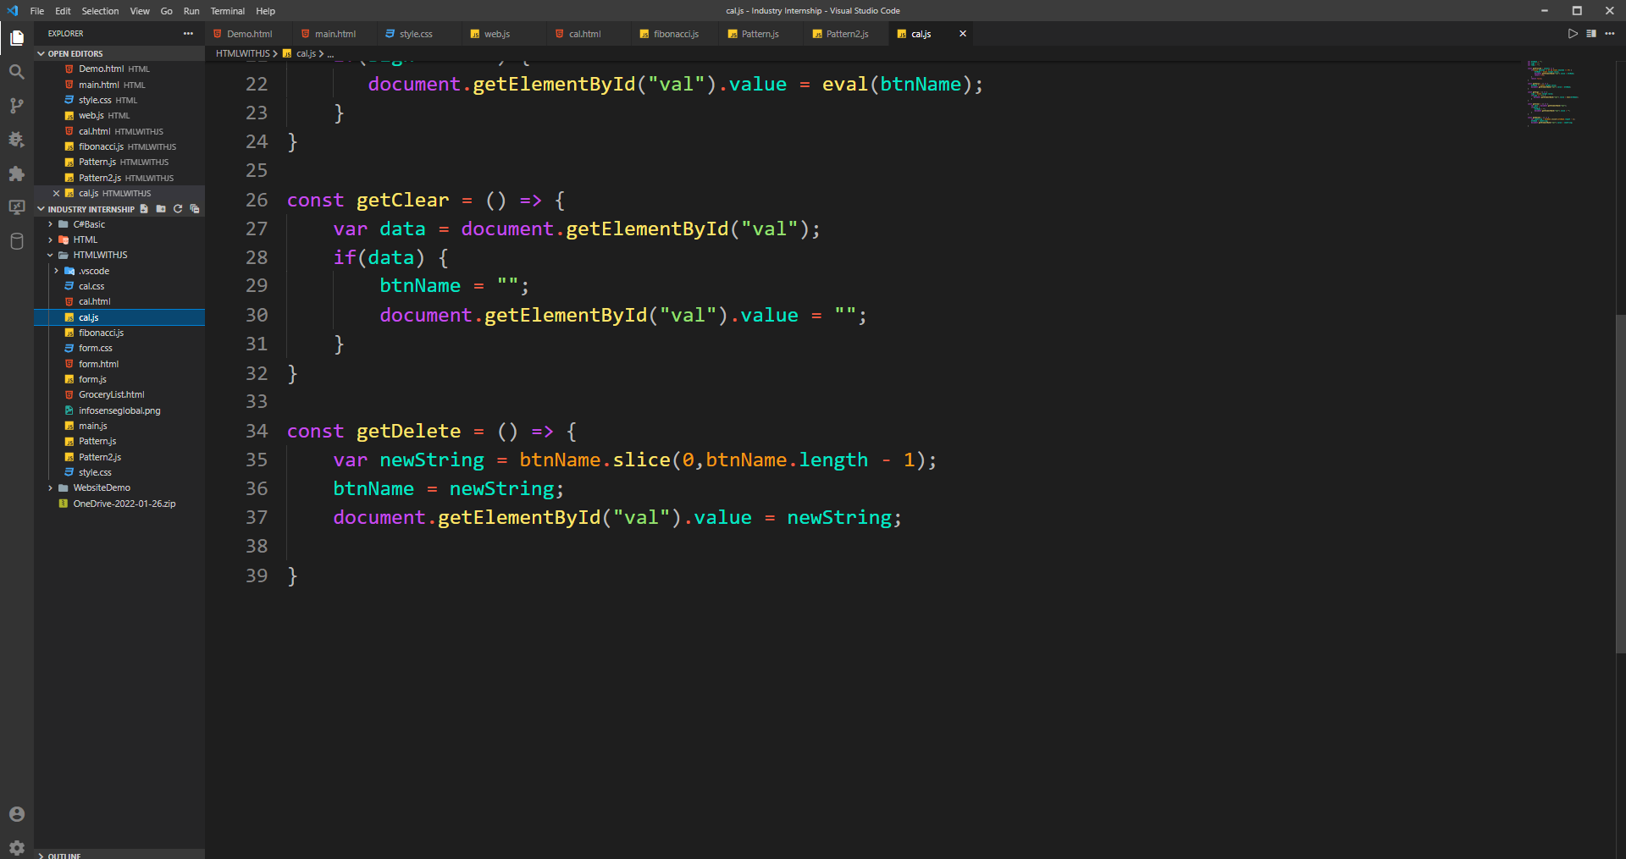
Calculator javascript code file

Slide 38
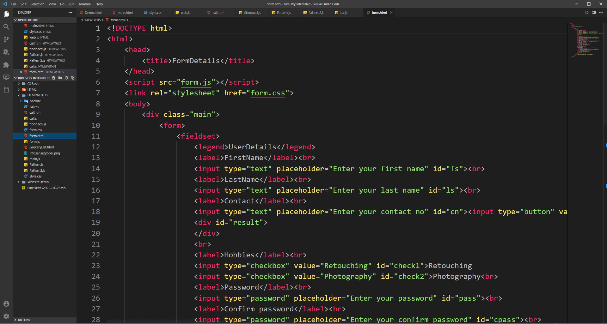
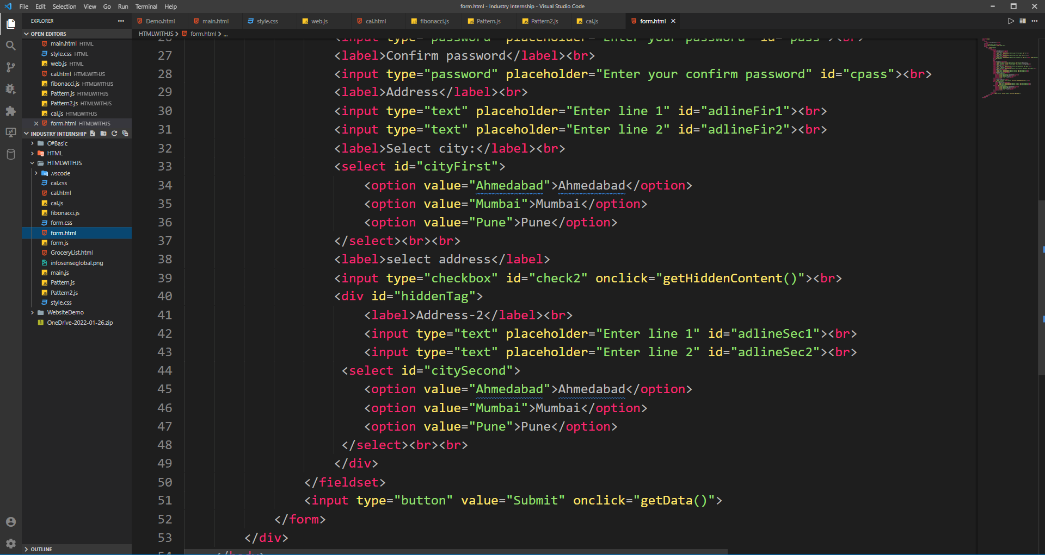
Form using javascript(html)

Slide 39



Form using javascript(js)

Slide 40

Form using javascript(Output)

Slide 41

Starting creating new website layout using HTML, CSS

Slide 42
Project definition
Project Title: Recruitment Management System
Hardware: windows
Tech: Angular, dotnet, SQLserver
Project def: This System is Designed to Manage the Recruitment Process. It is a set of tools designed to automate and manage your organization's recruiting and staffing operations. From posting new jobs to keeping applicants connected and engaged throughout.

Slide 43
Research works
System flow(offline)
Analysis of position
What kind of required employees we need (experienced or freshers)
Talent search
1)internal
2)external

Slide 44
Continue:
1)Internal
Promotions
Transfer
Internal advertisement
Employee referrals
2)external
Direct recruitment
Employment agencies
Advertisement
Campus recruitment
referrals

Slide 45
Screening the candidates
Filtration of applicants
Receive resumes and cover letters
Identifying top candidates
Scheduling interview for shortlisted candidates
Evalution's and offers employment(job offer)
Costs to take recruitments
Salaries of recruiters
Advertisement costs
Overtime and outstanding costs
Time taken by recruiters to create job applications and management

Slide 46

C#Task List

Slide 47

Applying thread concept in this task

Slide 48

Applying thread concept in this task

Slide 49


Slide 50

Now starting with mvc structure in ASP.NET

Slide 51

MainController

Slide 52

Model File

Slide 53


Slide 54

Post API calling:

Slide 55

Creating new Controller called Student

Slide 56


Slide 57


Slide 58

Homepage of MVC File structure

Slide 59

Using postman getting all student calling API's

Slide 60

Post API calling

Slide 61

Data appended on the file:

Slide 62

JQuery:

Slide 63

DOM traversing technique

Slide 64


Slide 65

JQuery File handling all events

Slide 66

Methods:

Slide 67

JQuery UI Methods

Slide 68

jQGrid

Slide 69

Exam module: c# task

Slide 70

Exam module: c# task

Slide 71


Slide 72


Slide 73

Output:

Slide 74

Creating web template using html css javascript

Slide 75


Slide 76


Slide 77


Slide 78

Main Css

Slide 79


Slide 80

JQuery for menu button

Slide 81

Layout:

Slide 82


Slide 83


Slide 84


Slide 85

Javascript Exam module:

Slide 86

Javascript main file

Slide 87


Slide 88


Slide 89

Storing form data in localstorage

Slide 90

Display table fatch data from localstorage

Slide 91

Code file:

Slide 92


Slide 93


Slide 94

Ondelete event data removed from table

Slide 95

Edit page jQuery:

Slide 96


Slide 97

Output

Slide 98


Slide 99


Slide 100

FlexBox using landingPage

Slide 101


Slide 102


Slide 103

Output:

Slide 104
References
Medium.com
Peoplehub.com
Hrhelpboard.com
Ideal.com
Zoho.com
Softwaresuggest.com
Caspio.com
Freeprojectz.com

Slide 105
Thank you

